Slide 1
BCCA figures
March 13 2025

Slide 2
Data % to report
X2.1.Flow.Type n prop
<chr> <int> <dbl>
1 Biotic 113 0.551
2 Human movement 21 0.102
3 Physical 38 0.185
4 Sociocultural 33 0.161

Slide 3
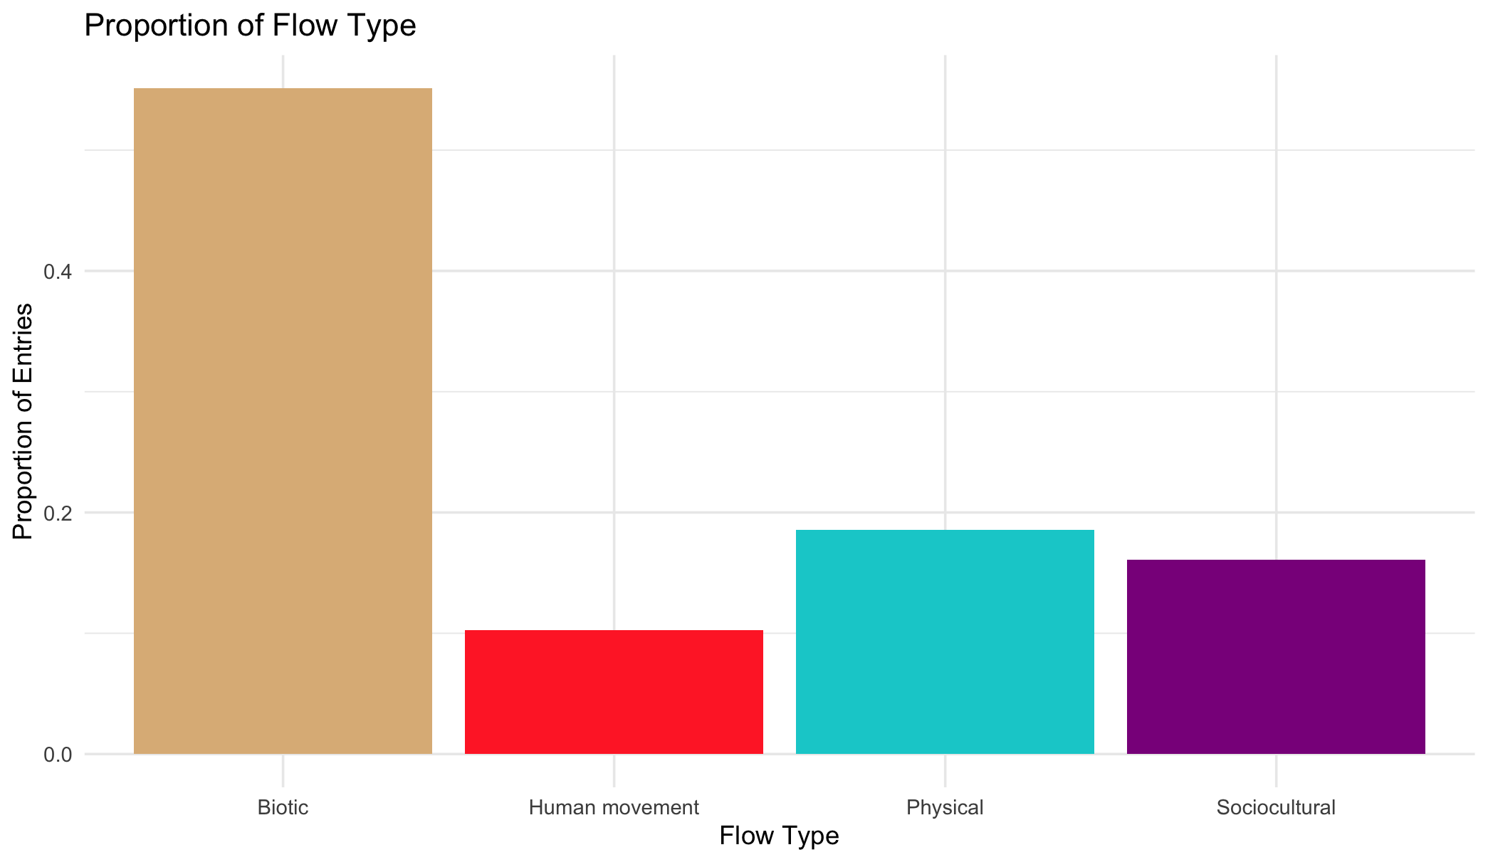

Slide 4
Multiple flows
Another.Flow. n prop
1 No 168 0.820
2 Yes 37 0.180

Slide 5
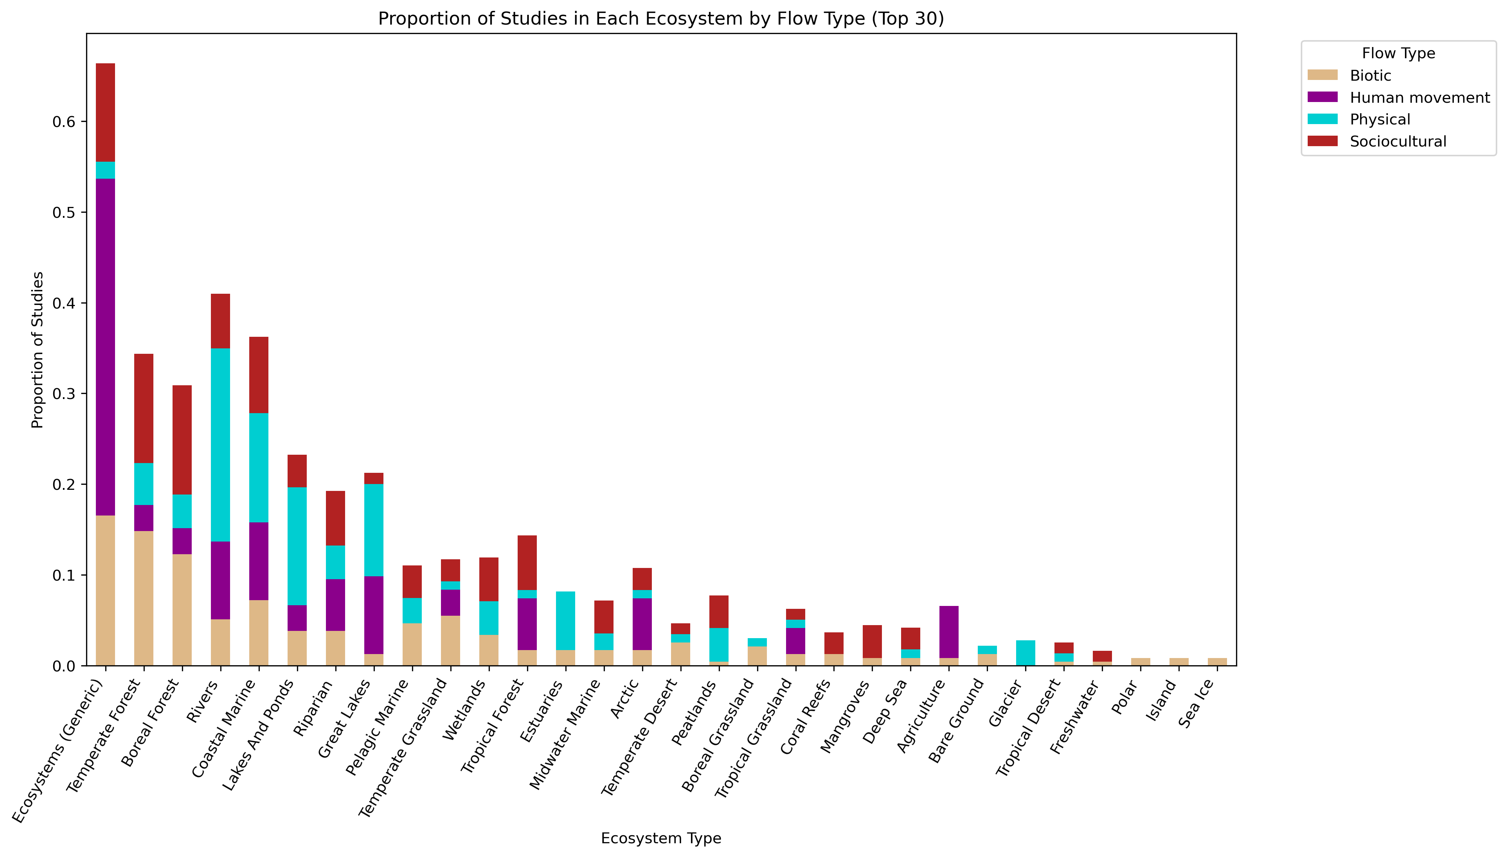
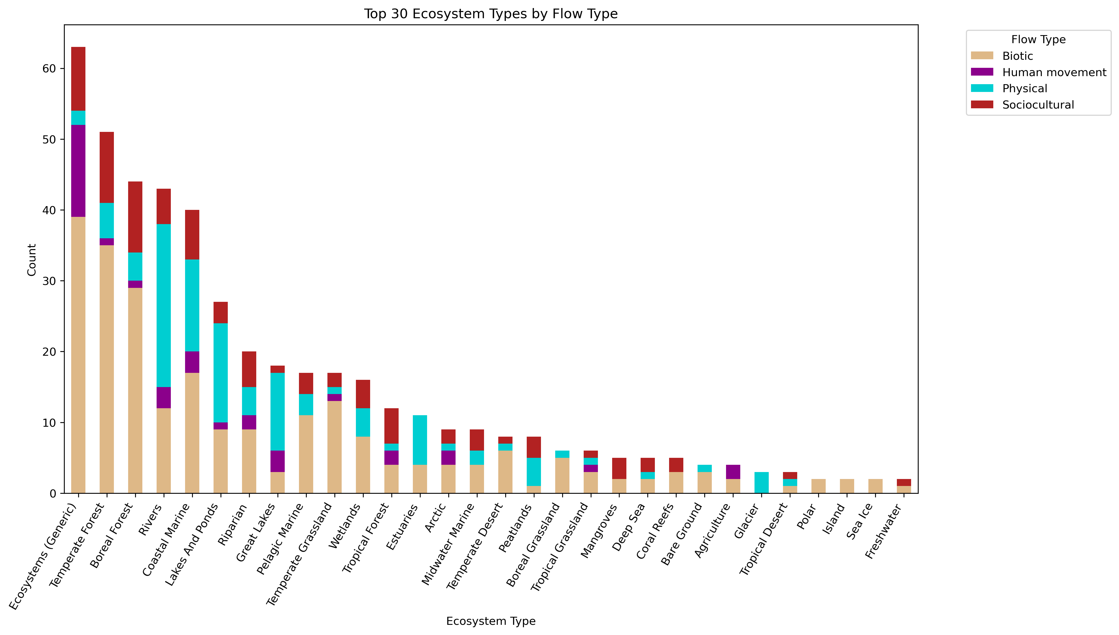

Slide 6
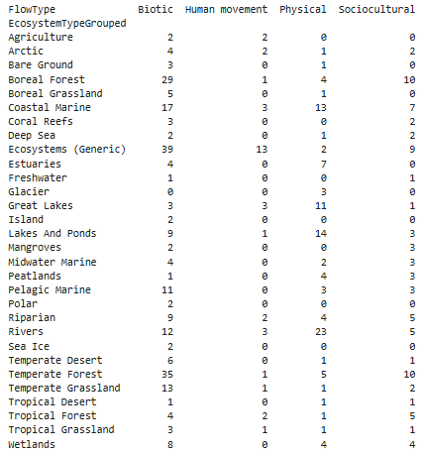
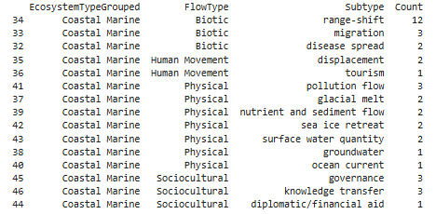

Slide 8
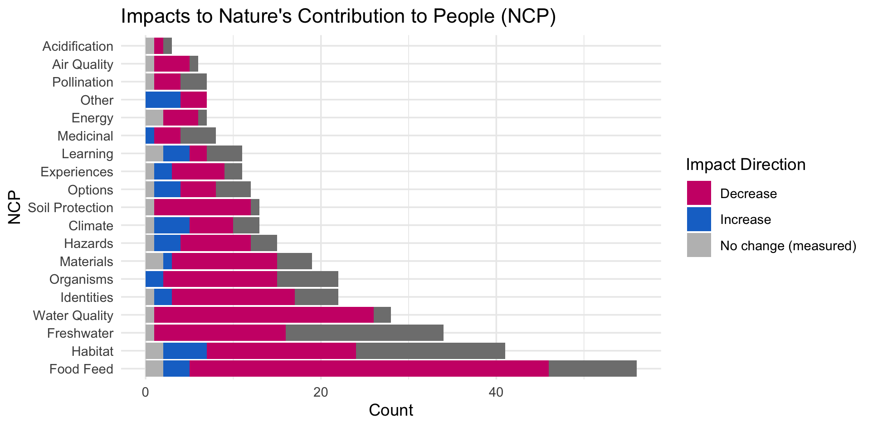

Slide 10
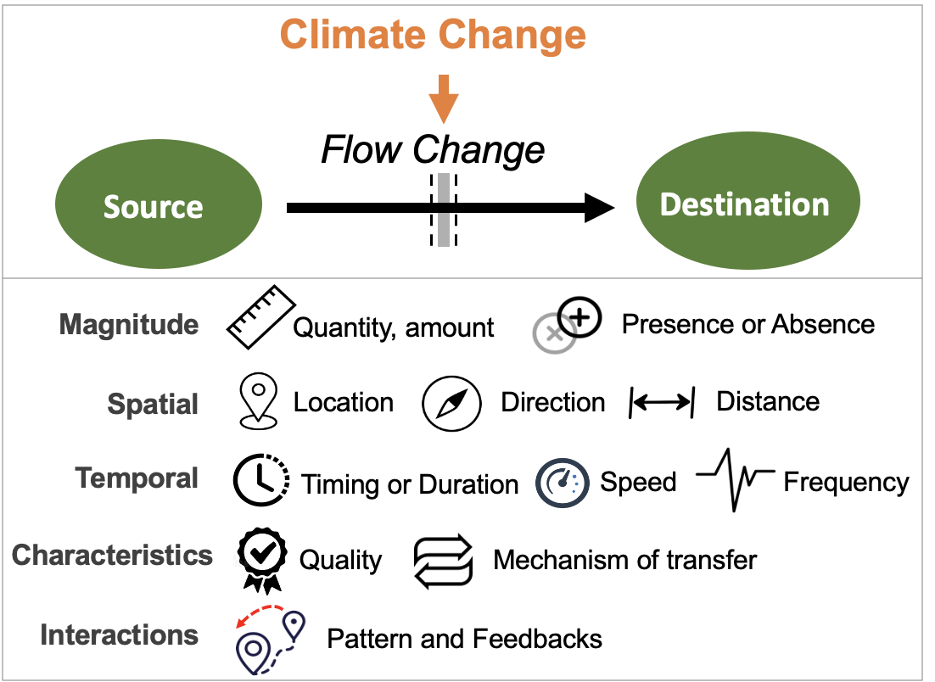
Most common paths
Climate change →

Slide 11
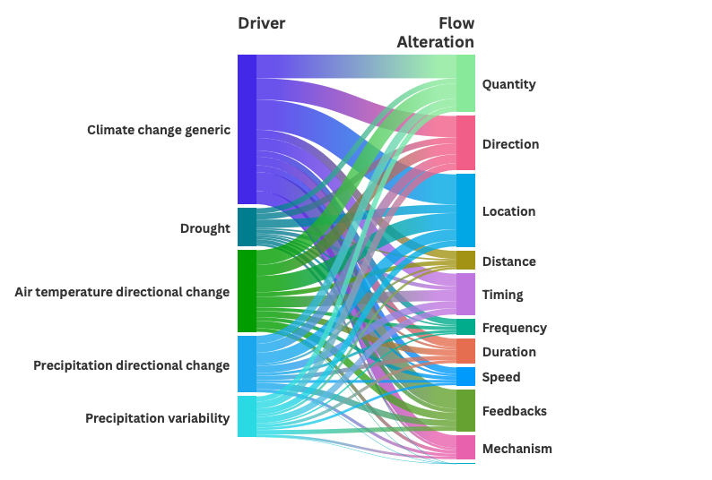

Slide 12
HWB studies count
# Cohesion Justice Other Relational Welfare
# 18 21 7 31 76

Slide 13
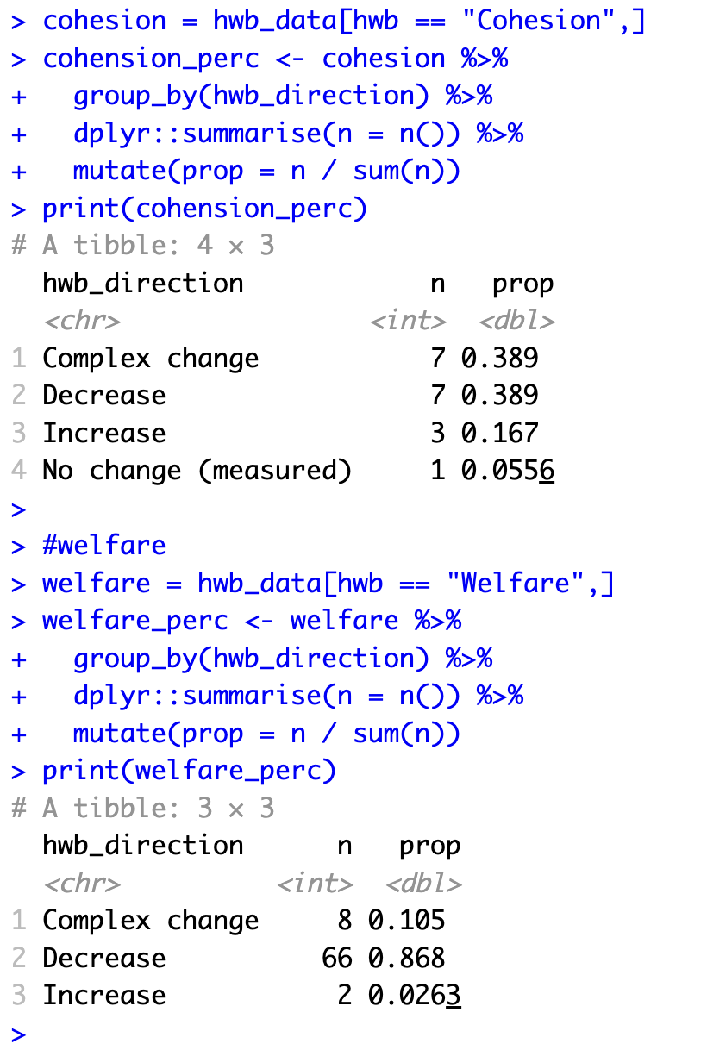
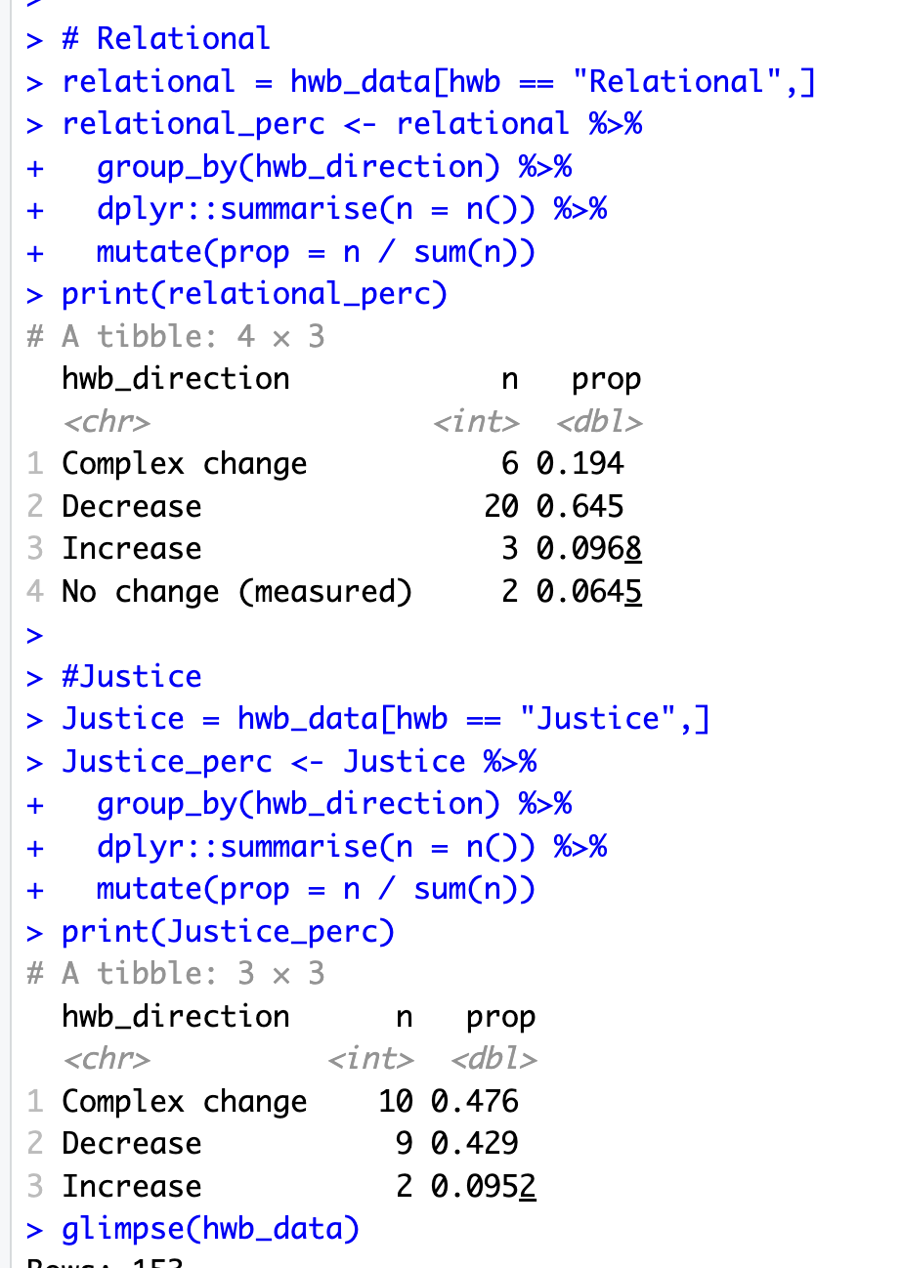

Slide 14
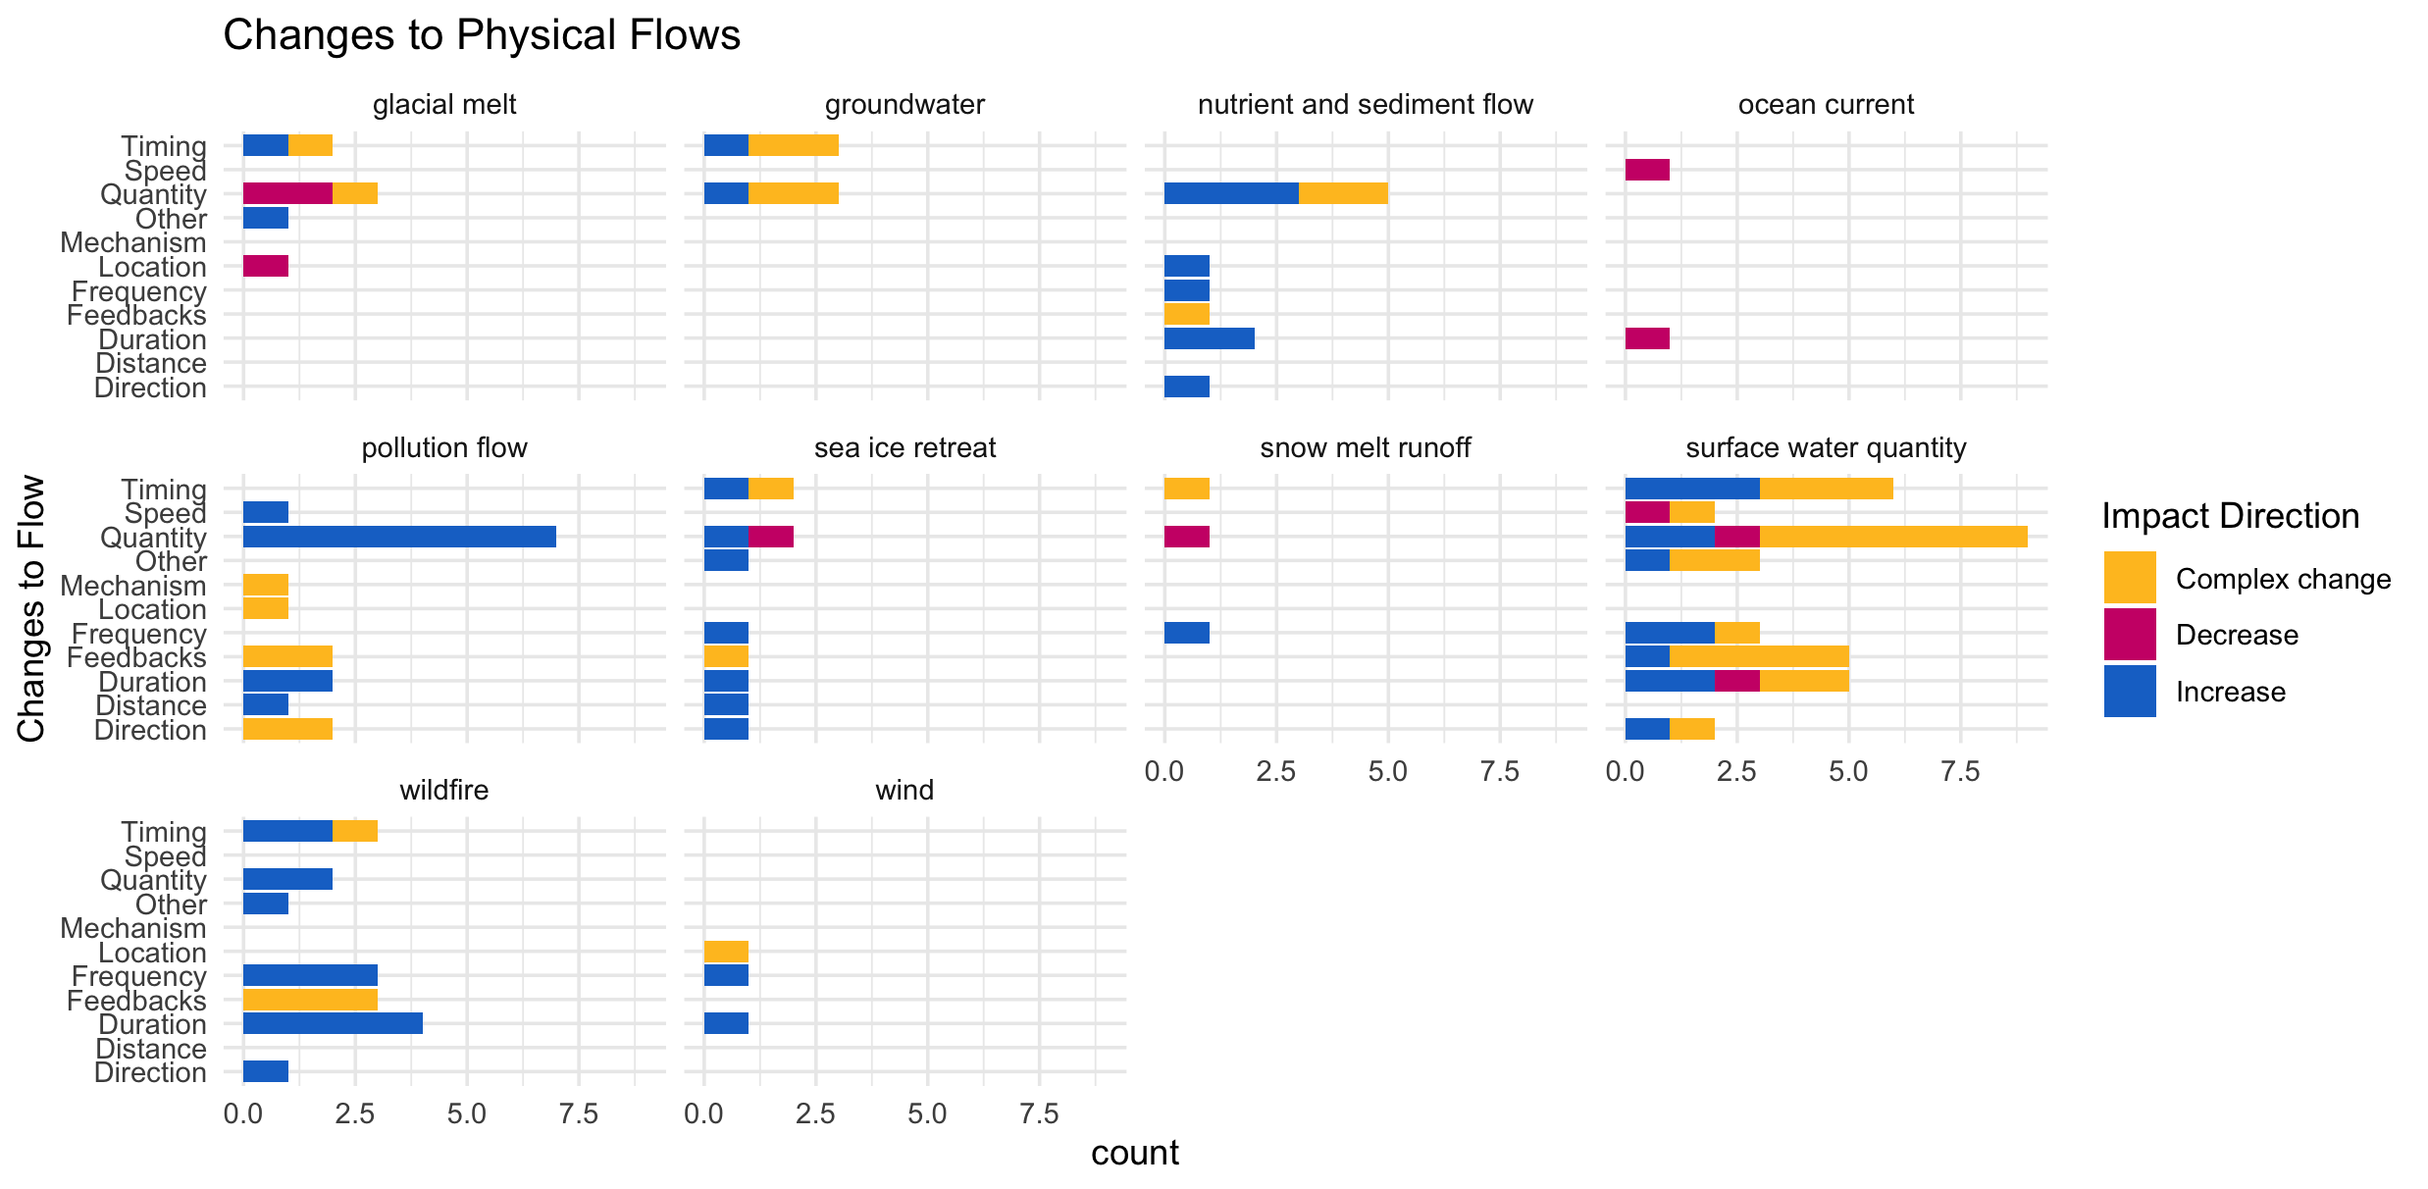

Slide 15
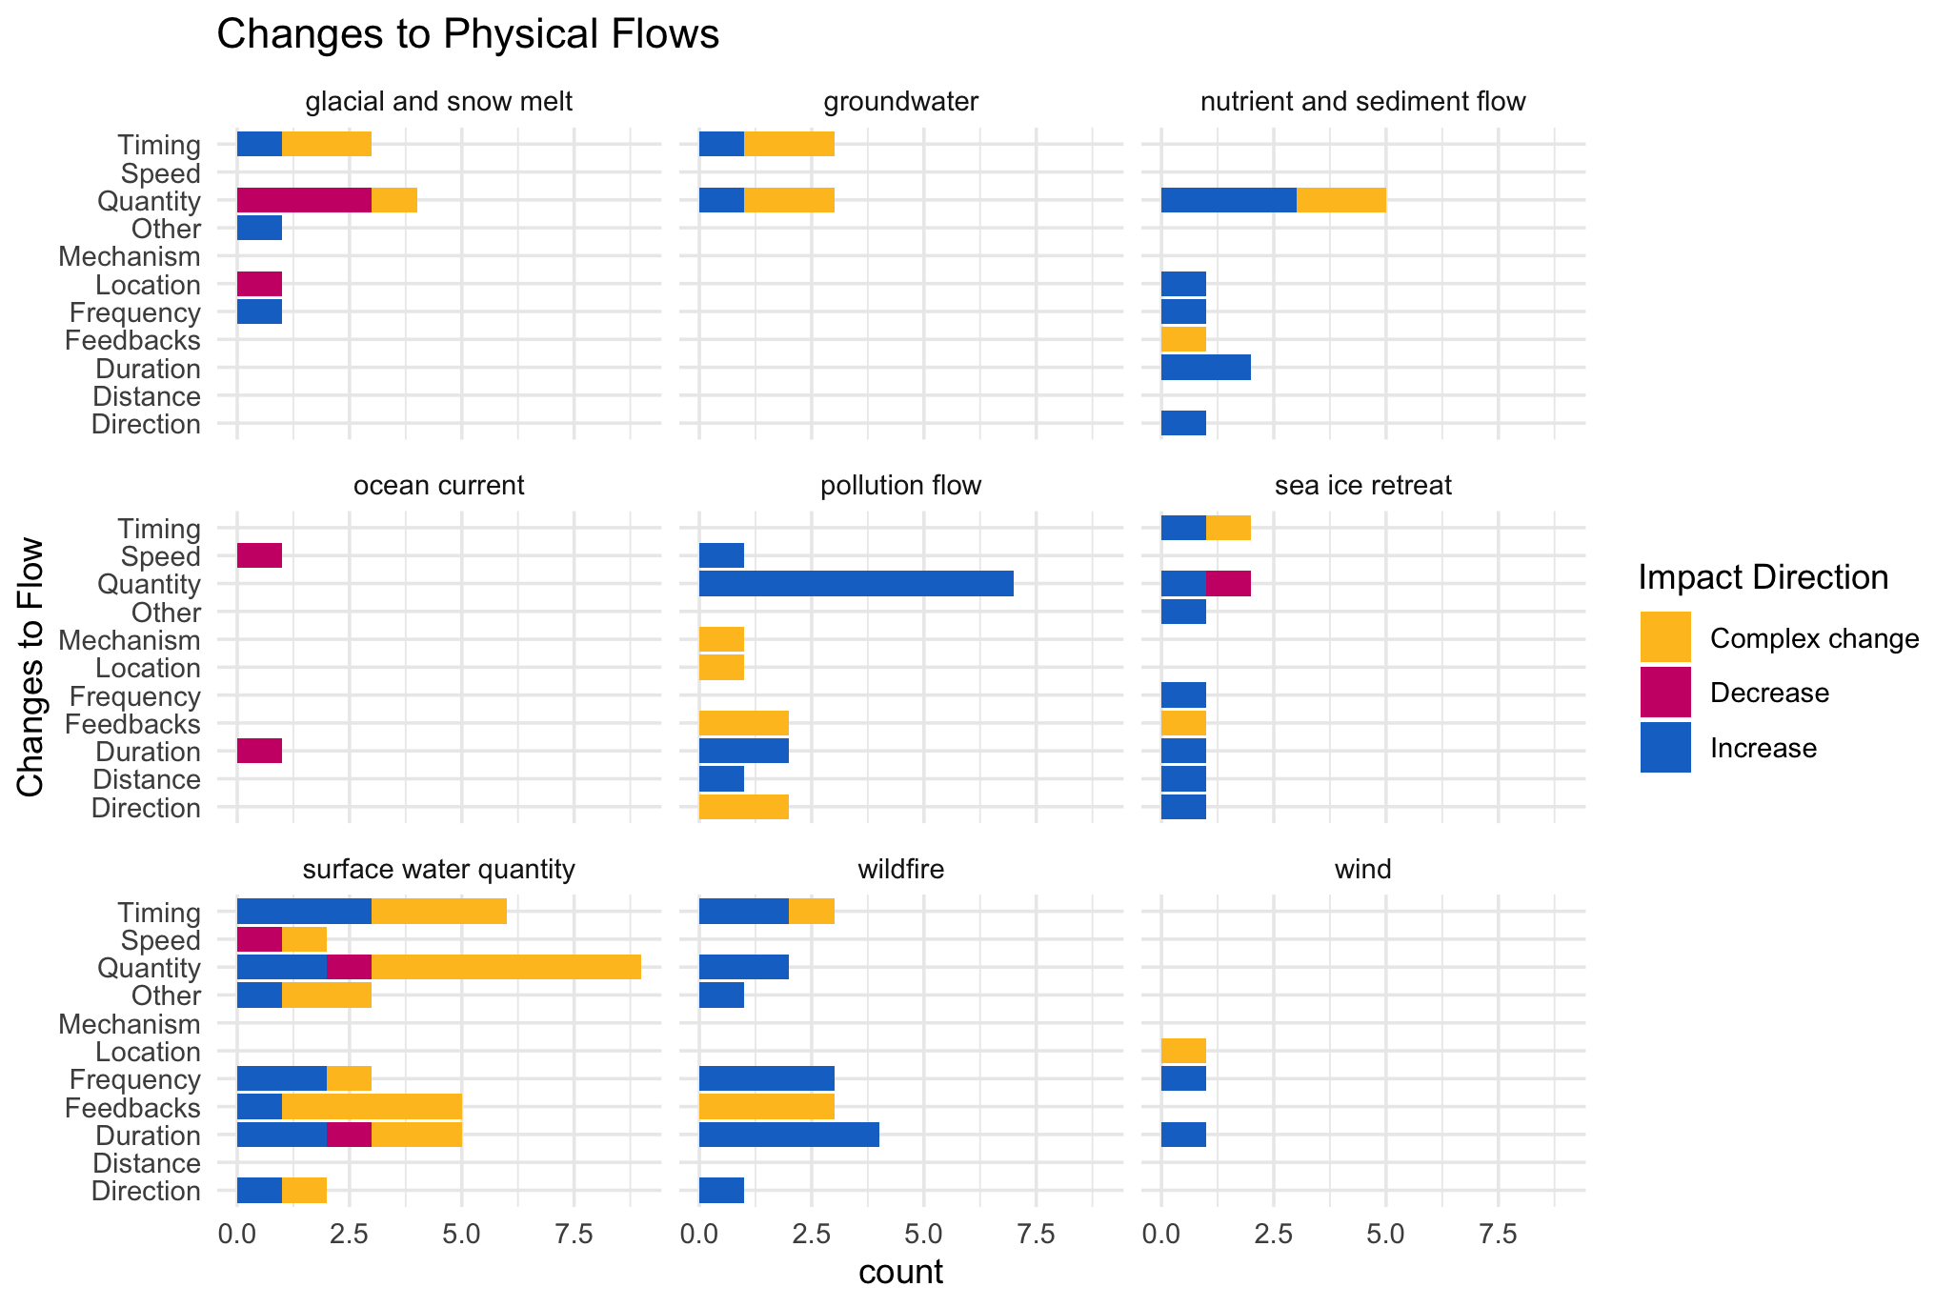

Slide 16
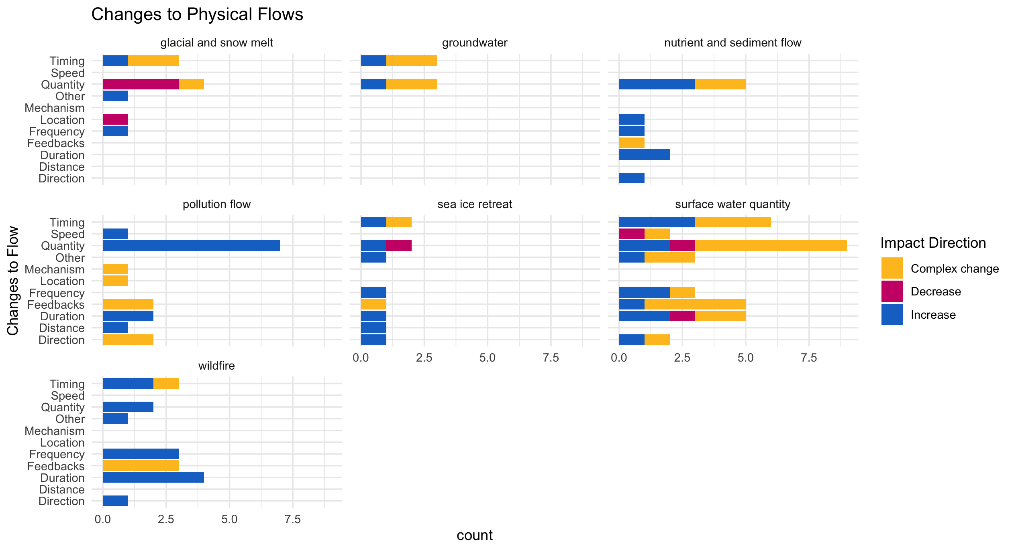

Slide 17
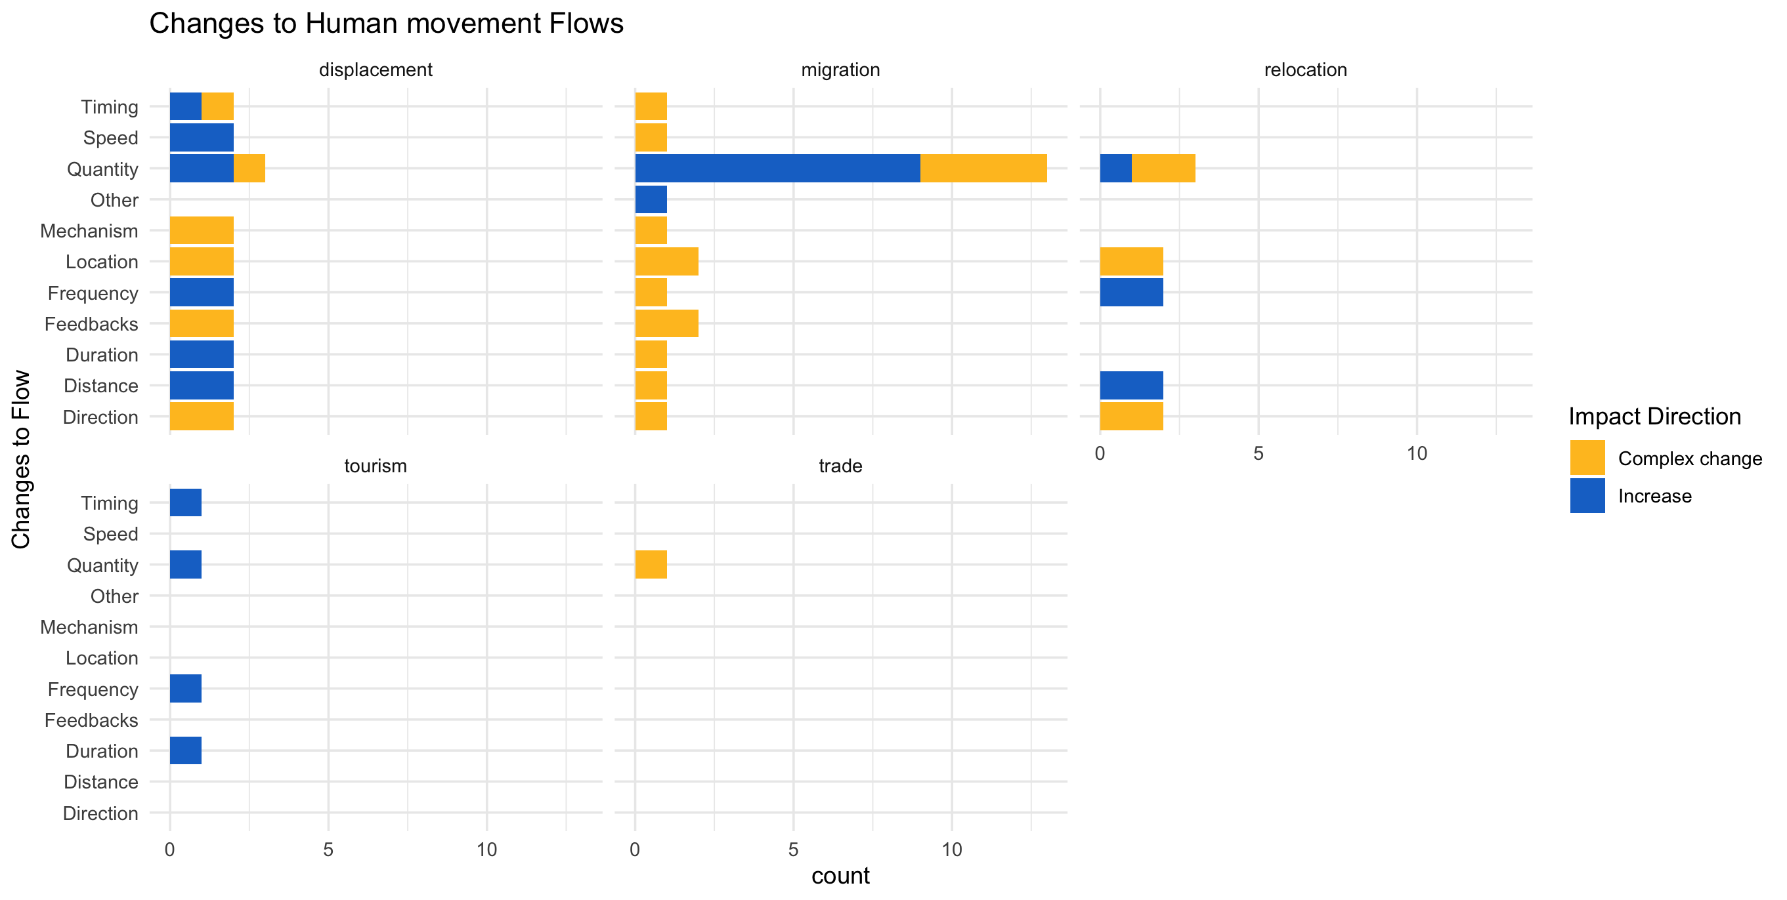

Slide 18
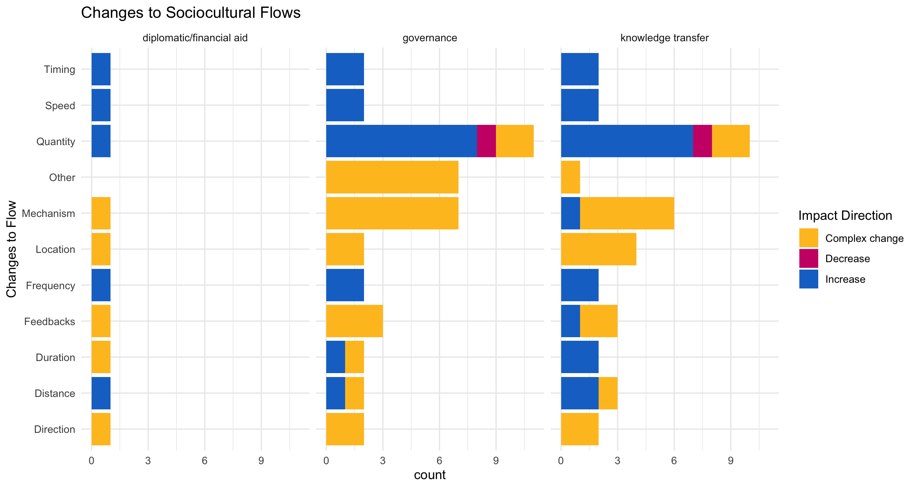

Slide 19
hwb_direction n prop
<chr> <int> <dbl>
1 Complex change 8 0.105
2 Decrease 66 0.868
3 Increase 2 0.0263

Slide 20
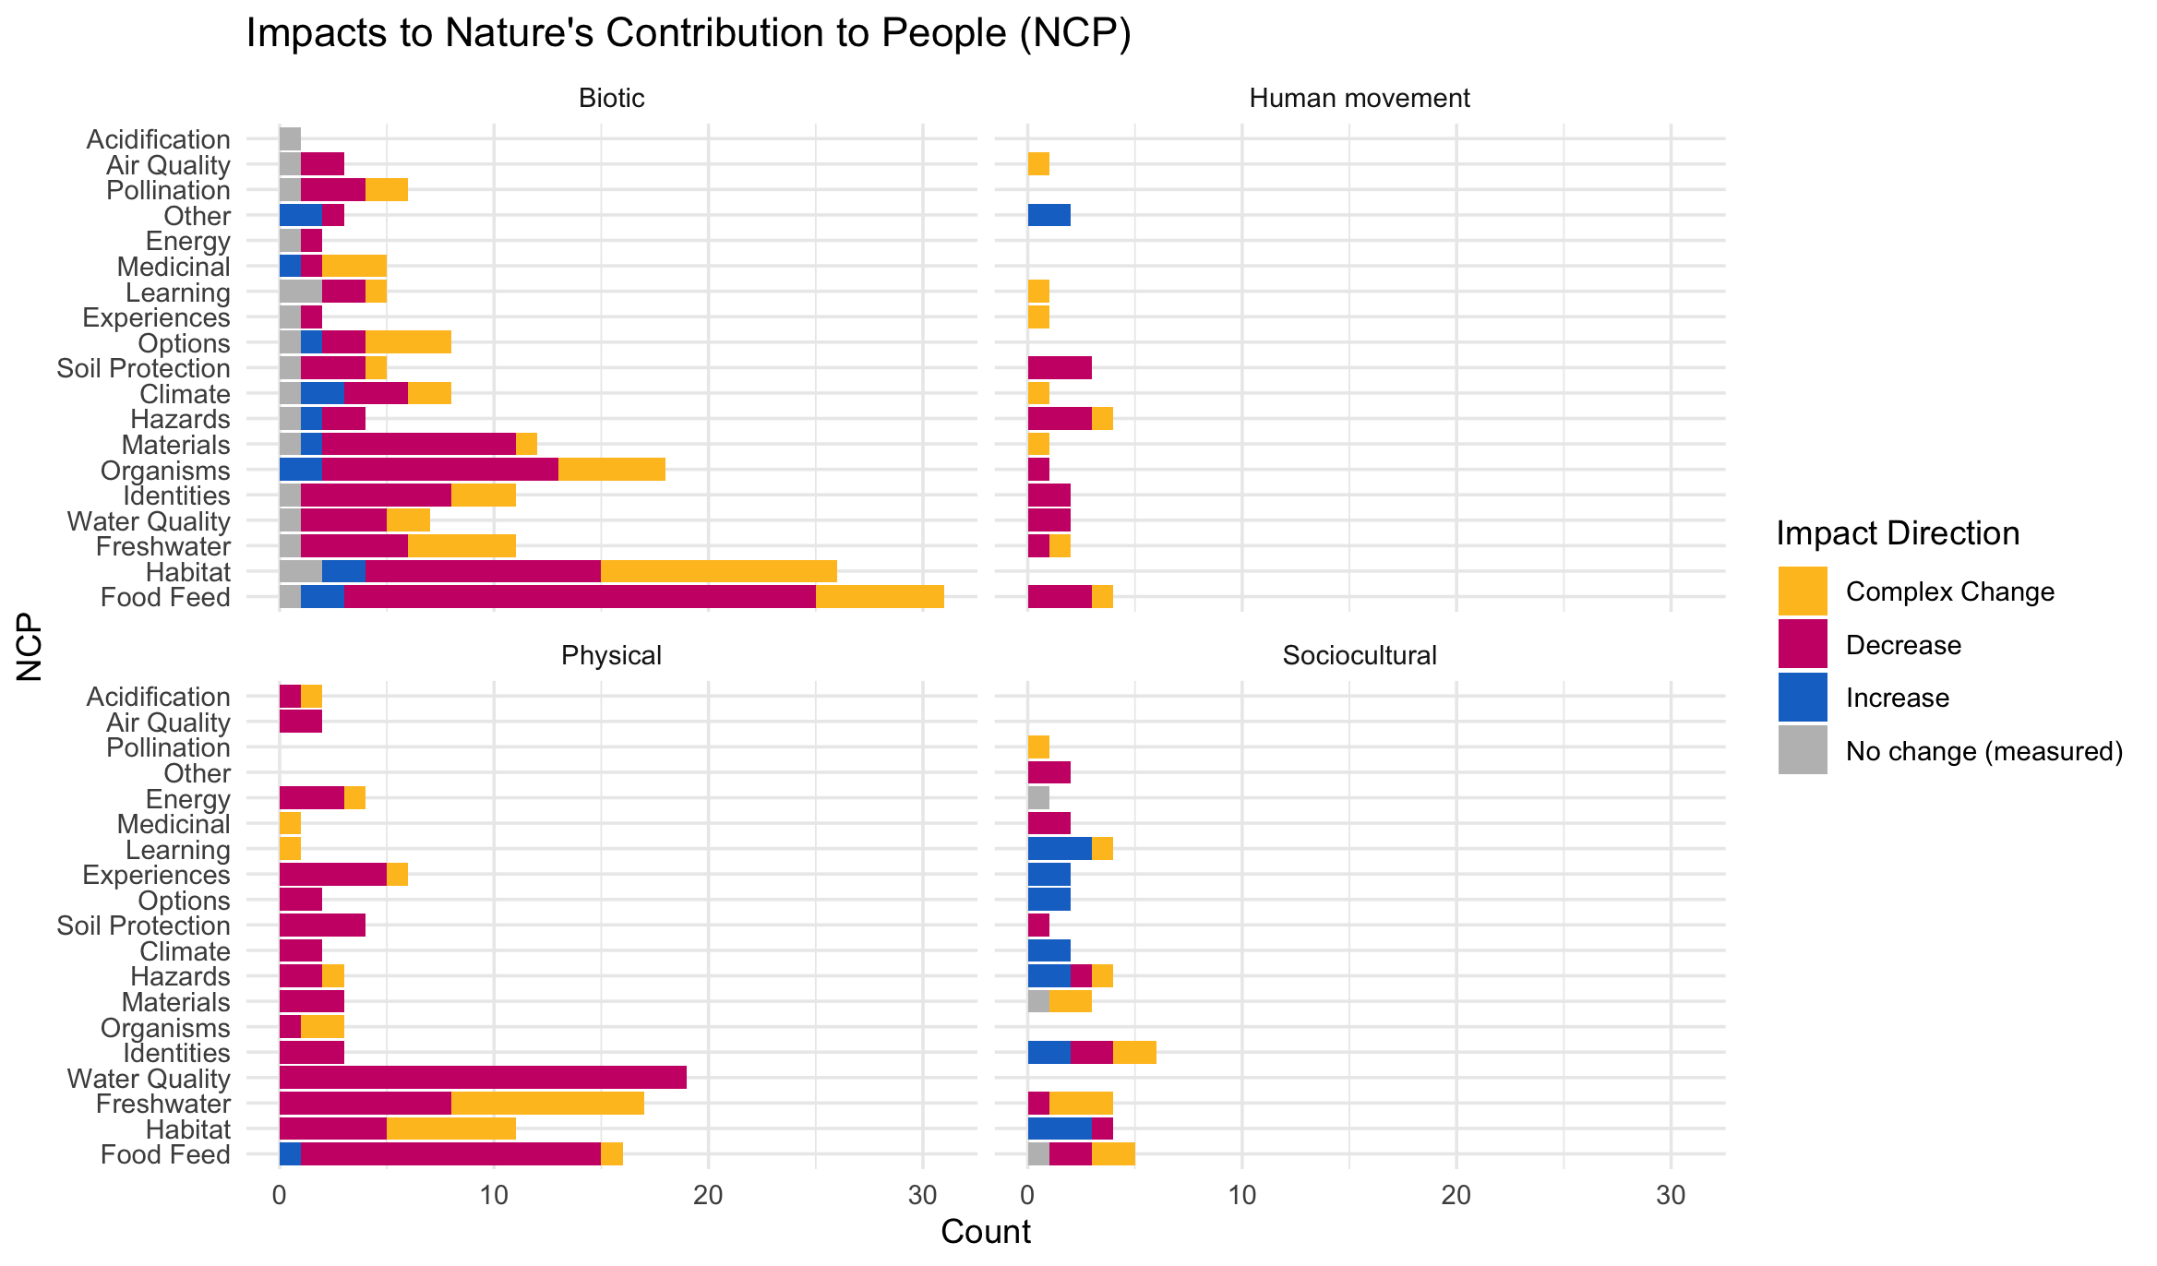

Slide 21
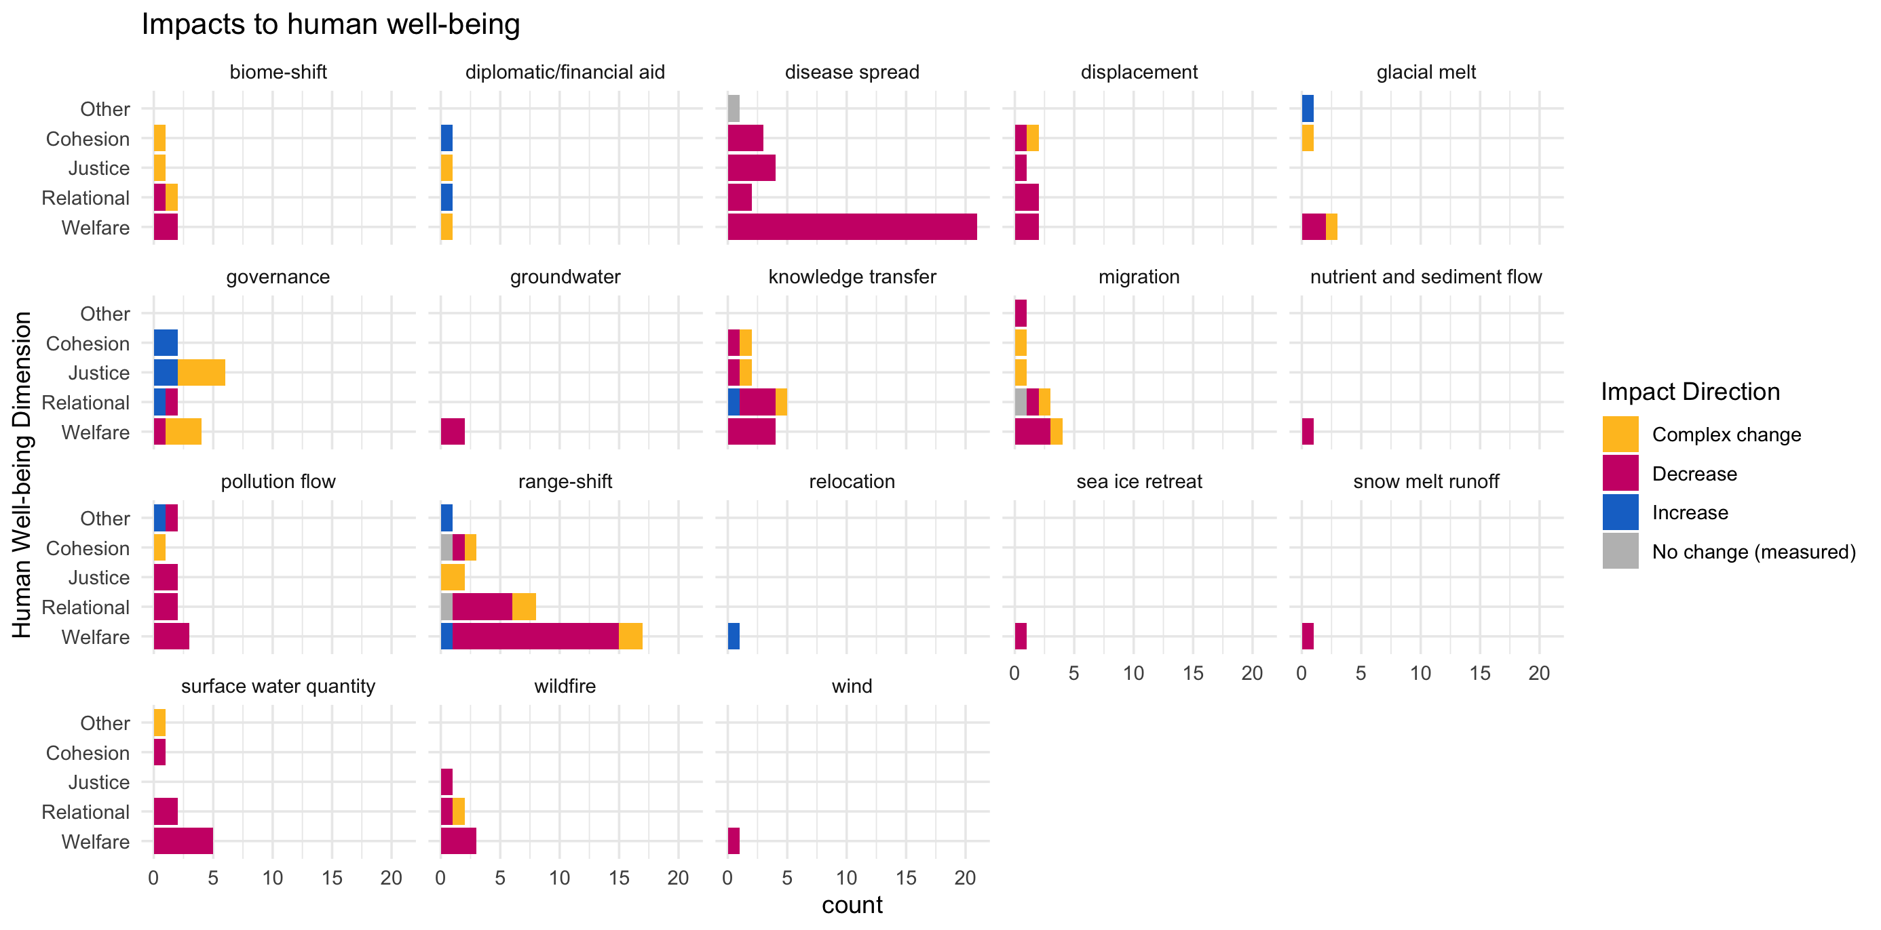

Slide 22
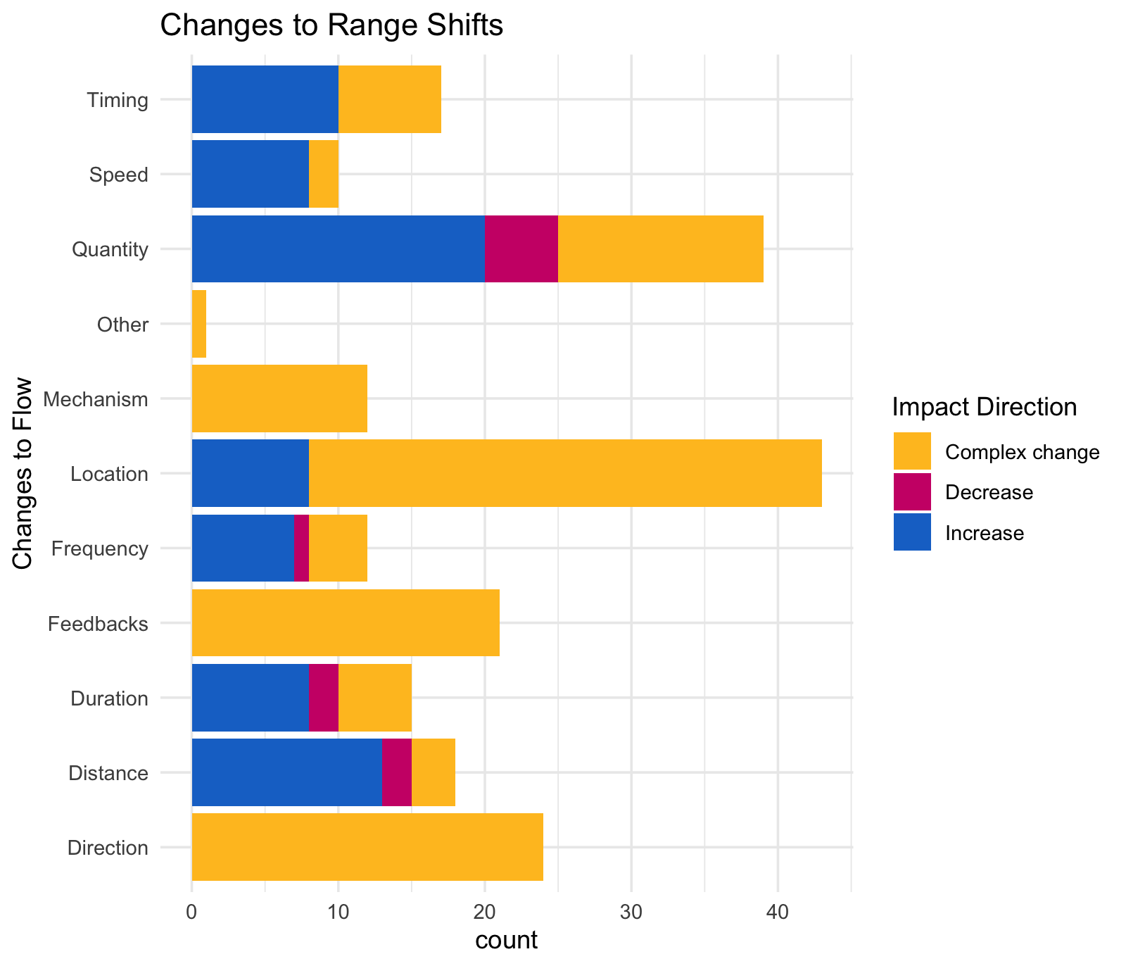

Slide 23
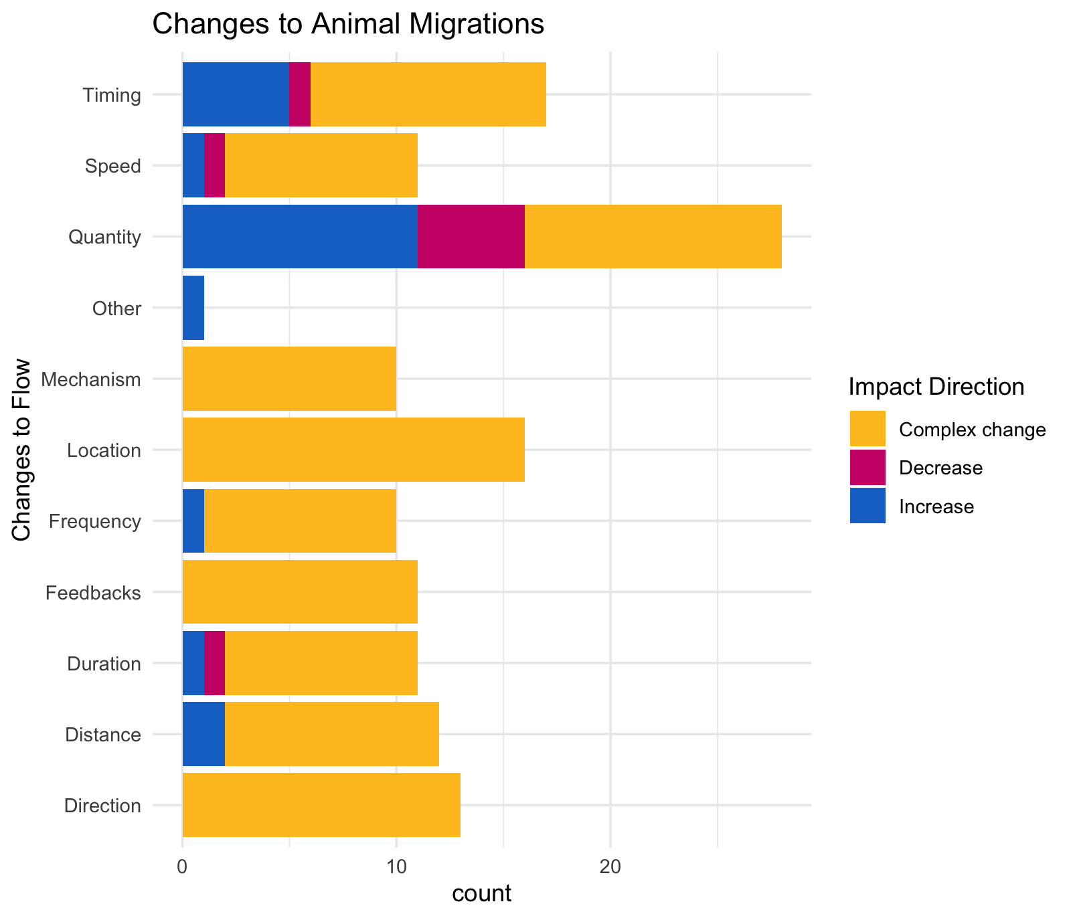

Slide 24
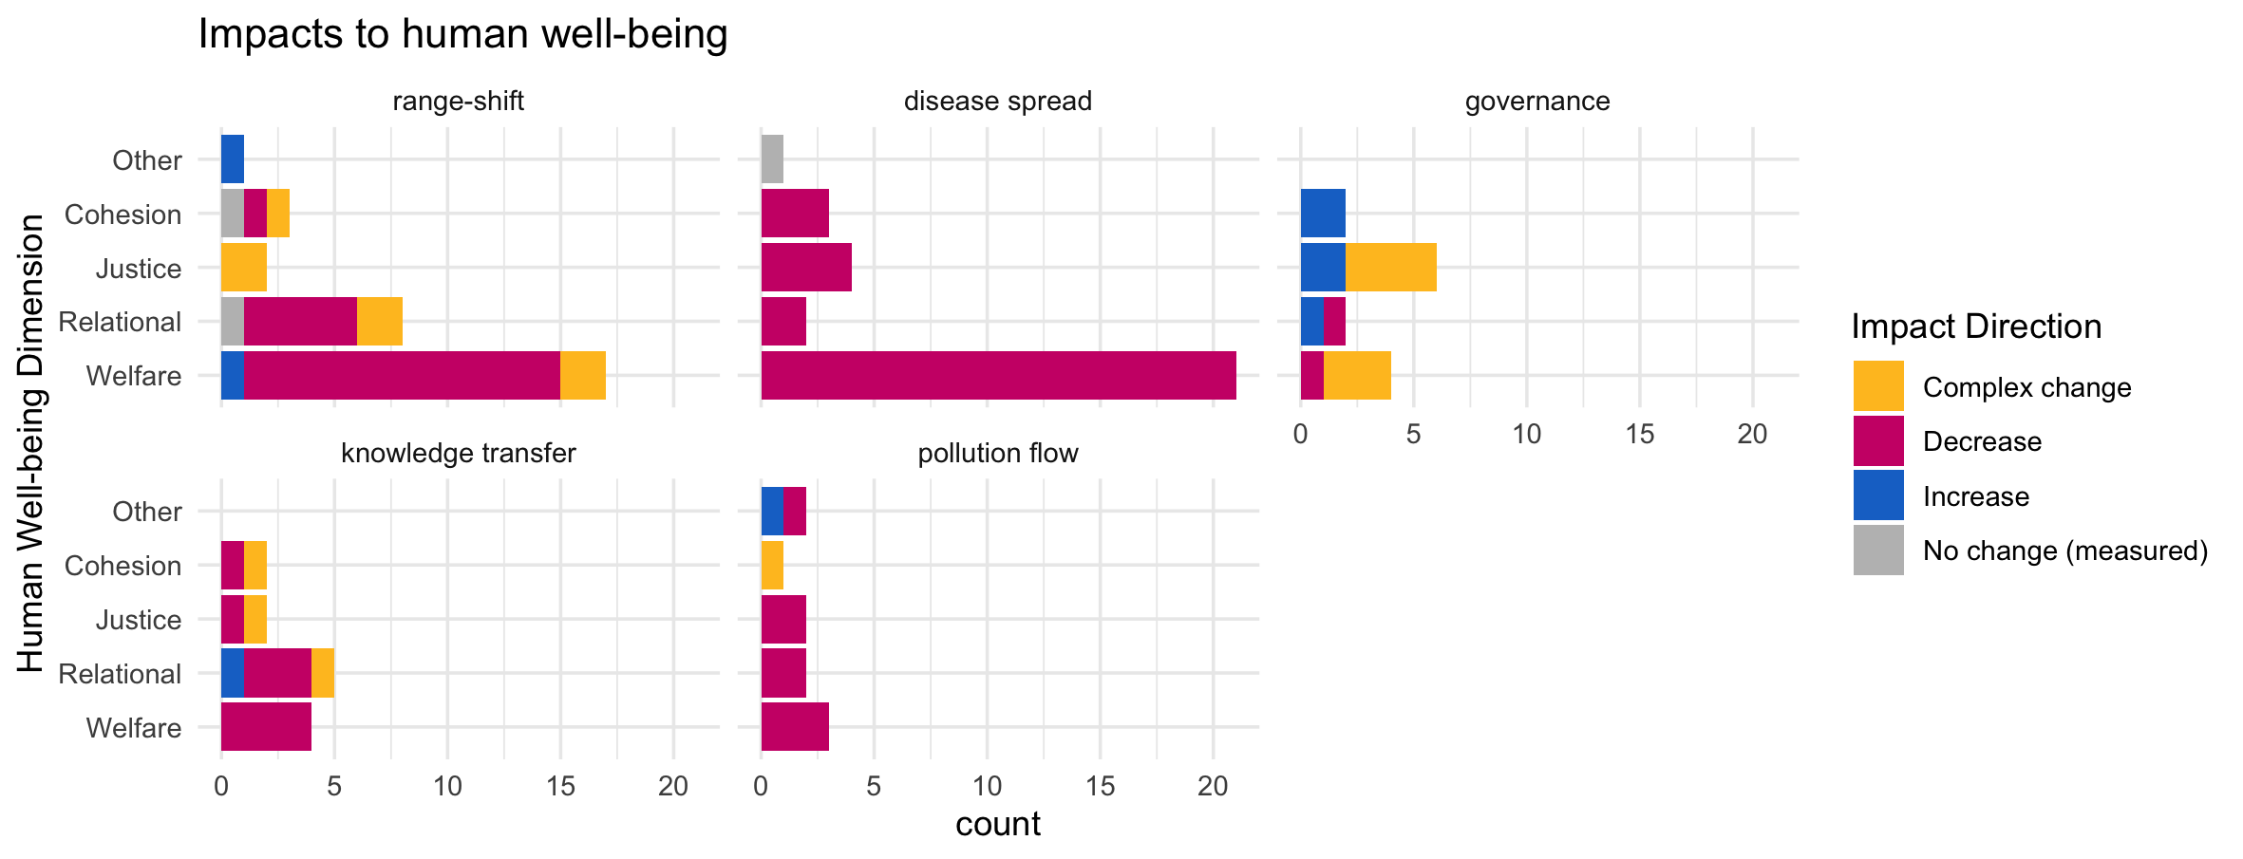

Slide 25
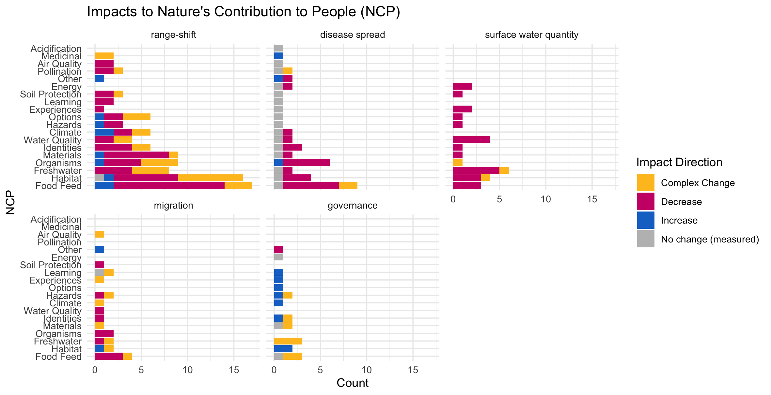

Slide 26
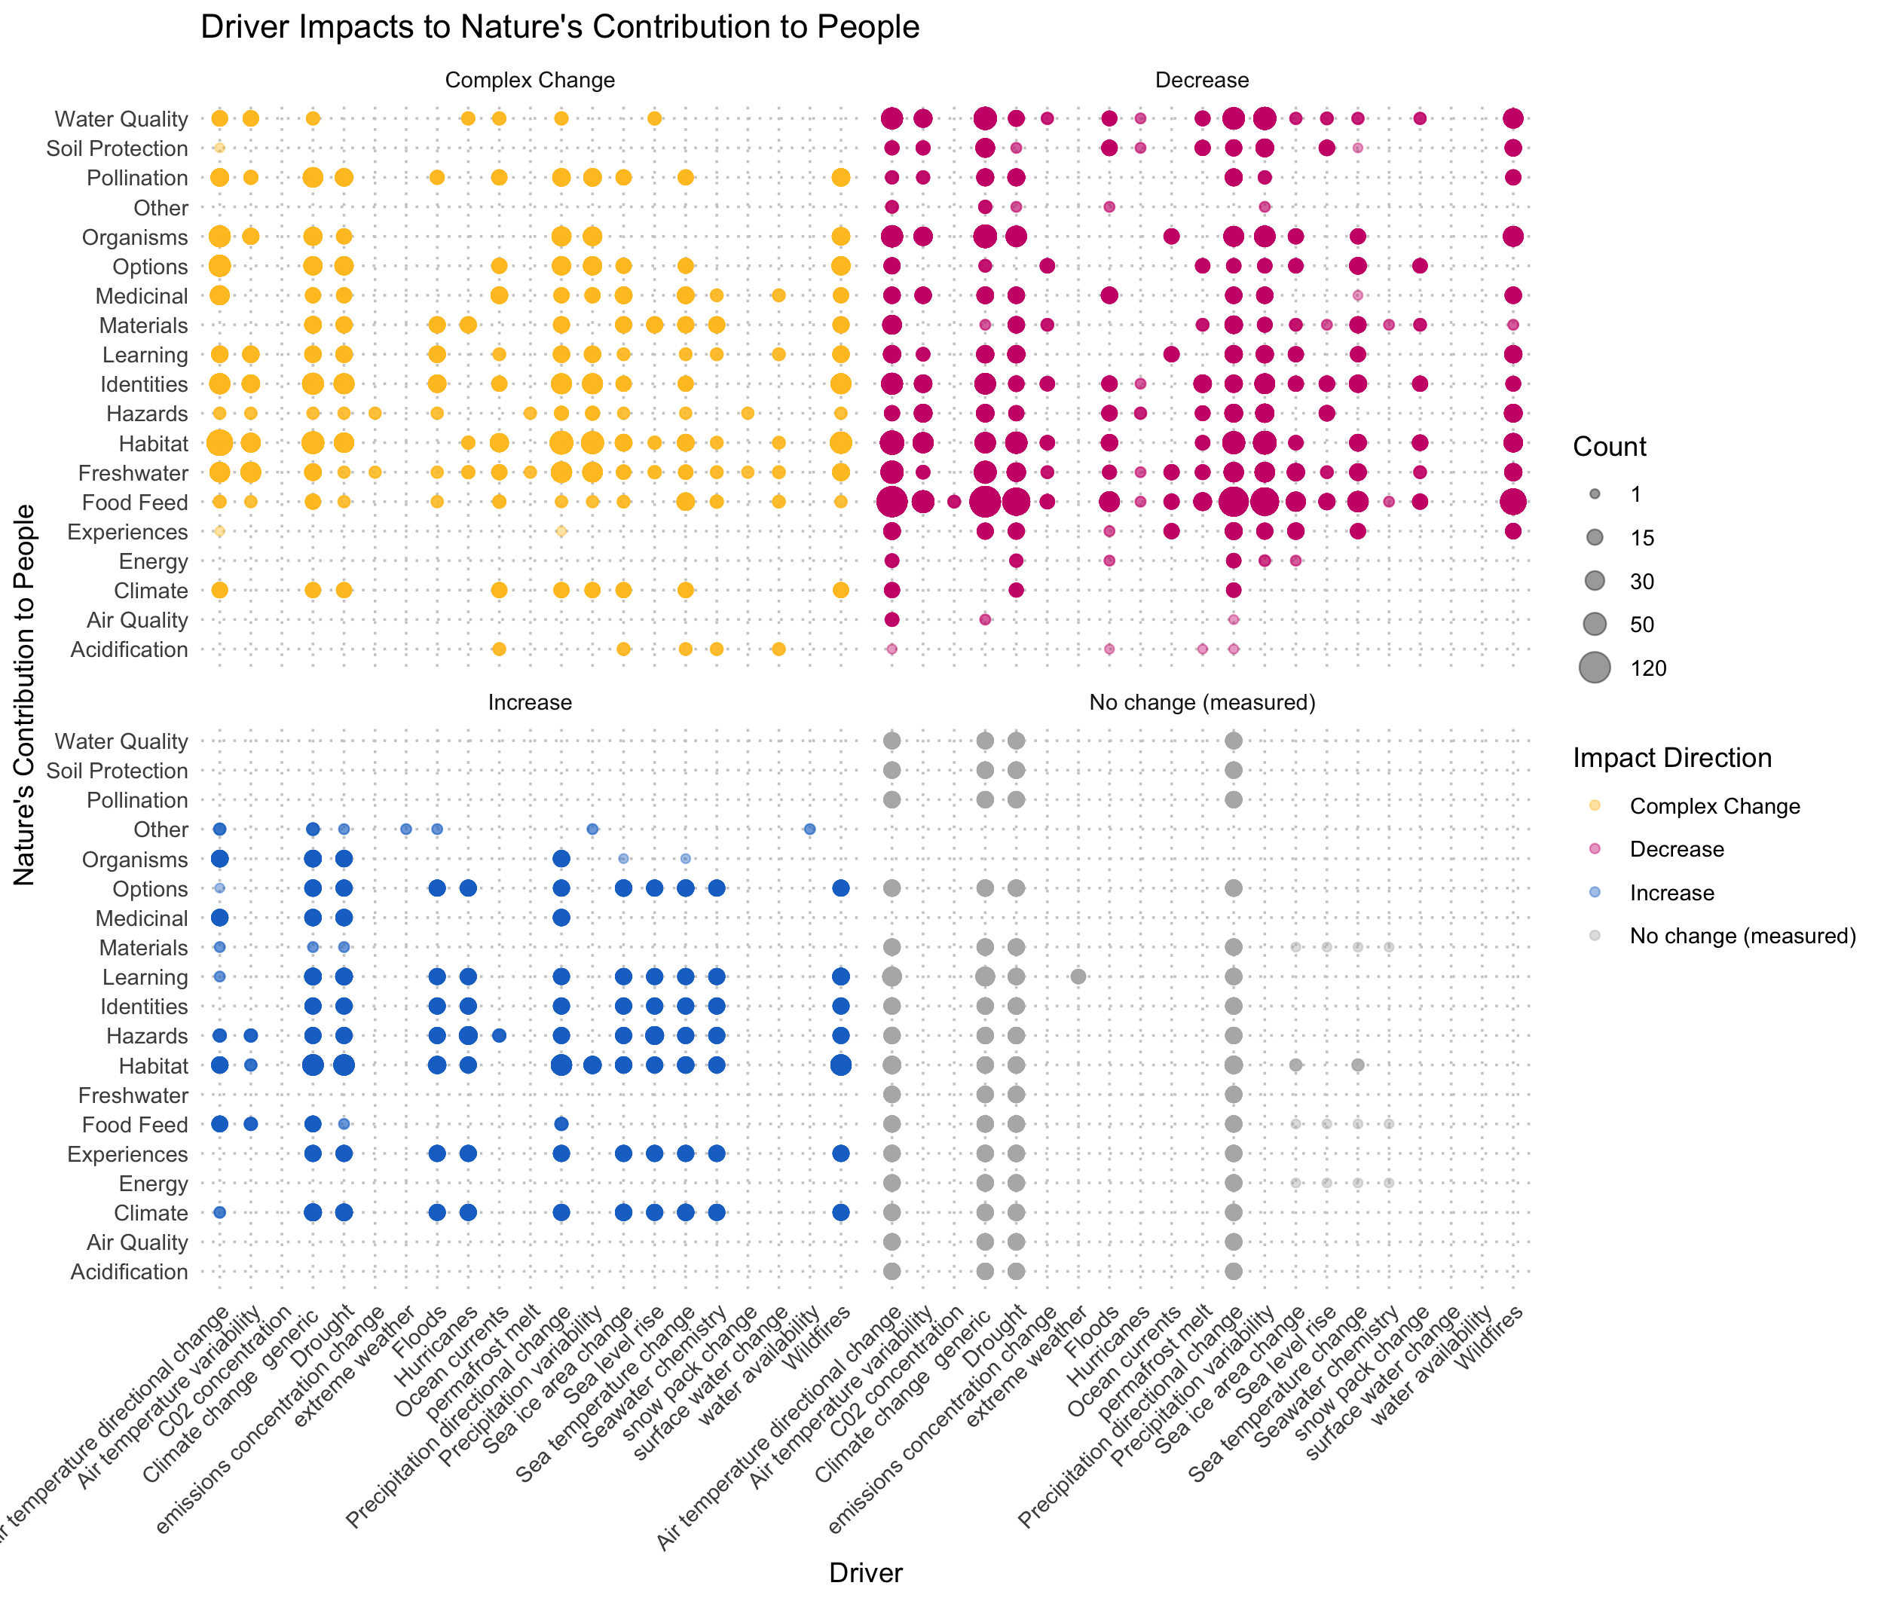

Slide 27
Should check the other
Cohesion Justice Other Relational Welfare
18 21 7 31 76
By far, the most studied element of human well-being in our study context was welfare (n = 76; ~50%), followed by relational (n=31; 20%), justice (n=21; 14%), and cohesion (n=18) dimensions of well-being (with 7 data points for other dimesions, including xxxxx).
The majority of evidence indicated decreasing welfare (86.8%) and relational well-being (64.5%) associated with climate-driven alteration of flow.
While fewer studies consider cohesion and justice, changes in justice were predominantly complex (47.6%) or decreasing (43%), with less than 10% increases, whereas the evidence for effects on cohesion were more mixed: 39% complex or decreasing, with 16.7 increasing and 5.6% with no change.
hwb n prop
<chr> <int> <dbl>
1 Cohesion 18 0.118
2 Justice 21 0.137
3 Other 7 0.0458
4 Relational 31 0.203
5 Welfare 76 0.497

Slide 28
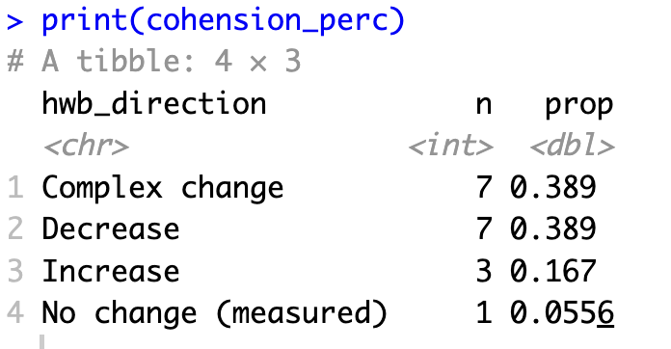
HWB trends: Cohesion

Slide 29
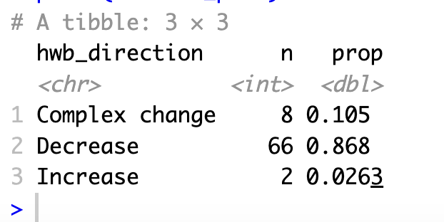
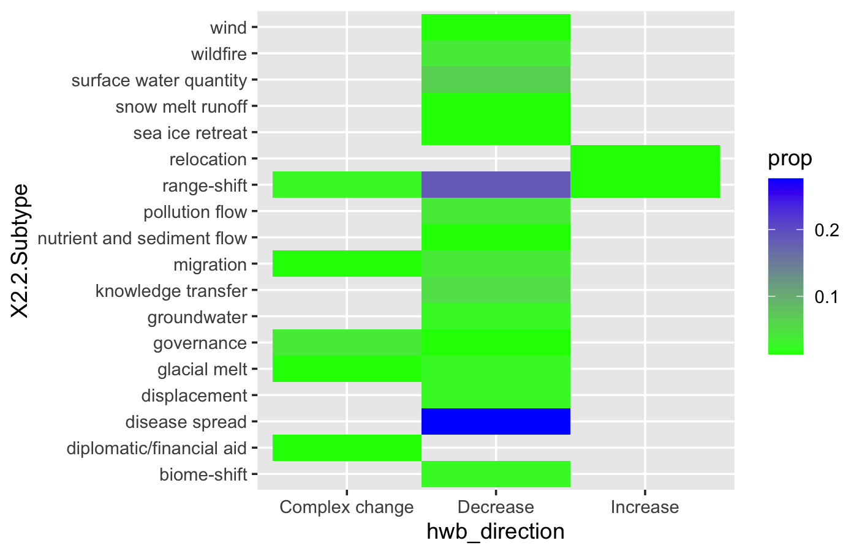
HWB trends: Welfare

Slide 30
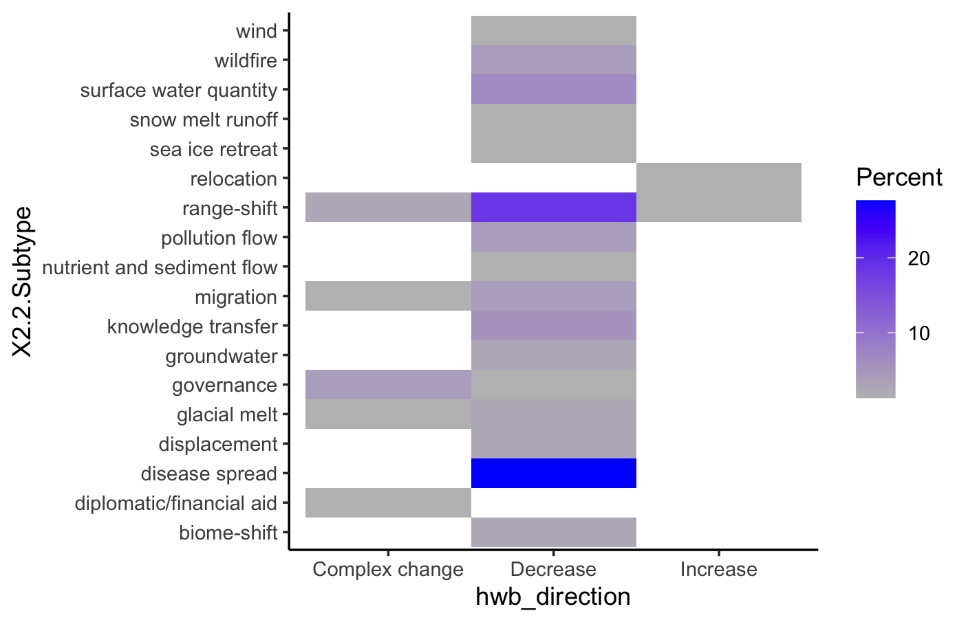

Slide 31
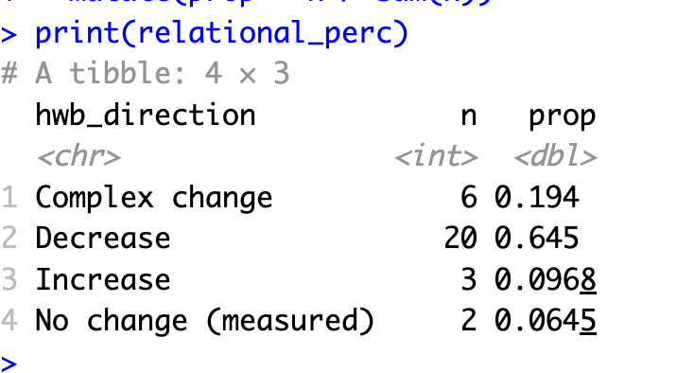
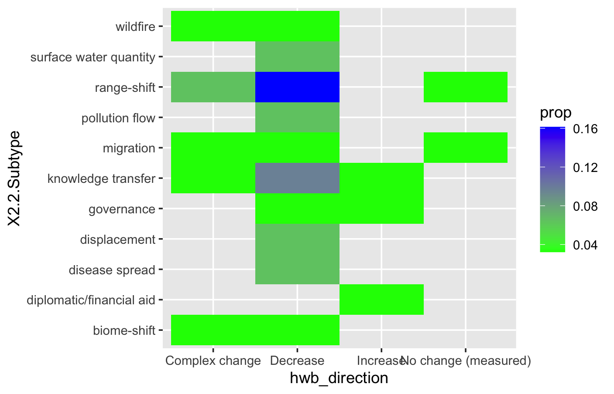
HWB trends: Relational

Slide 32
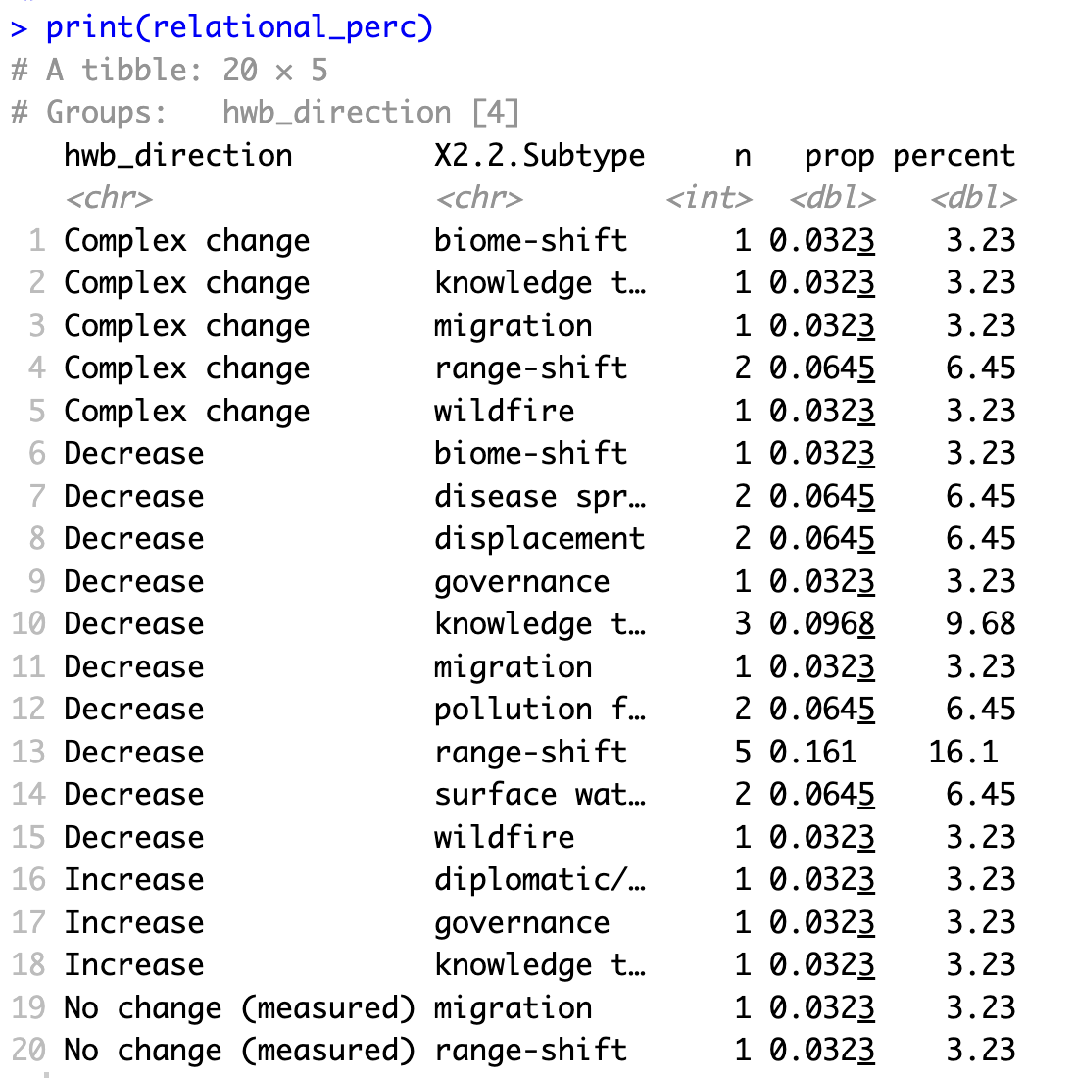

HWB trends: Relational

Slide 33
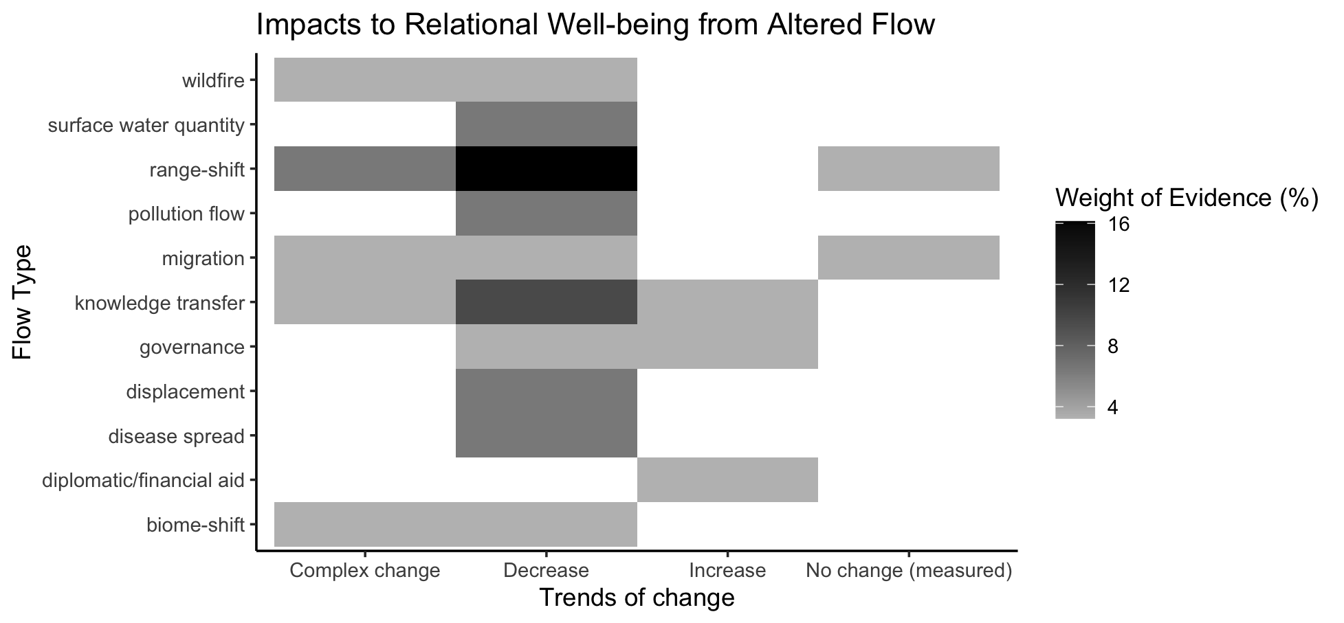
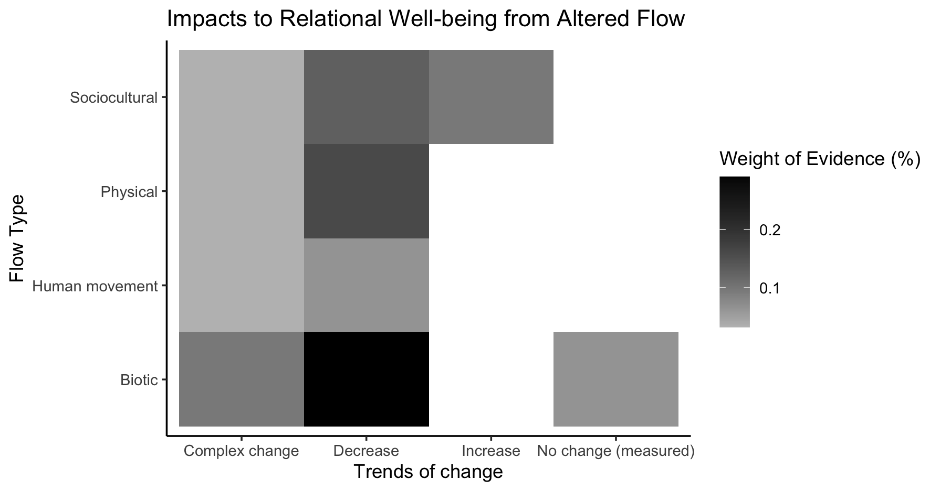
Relational

Slide 34
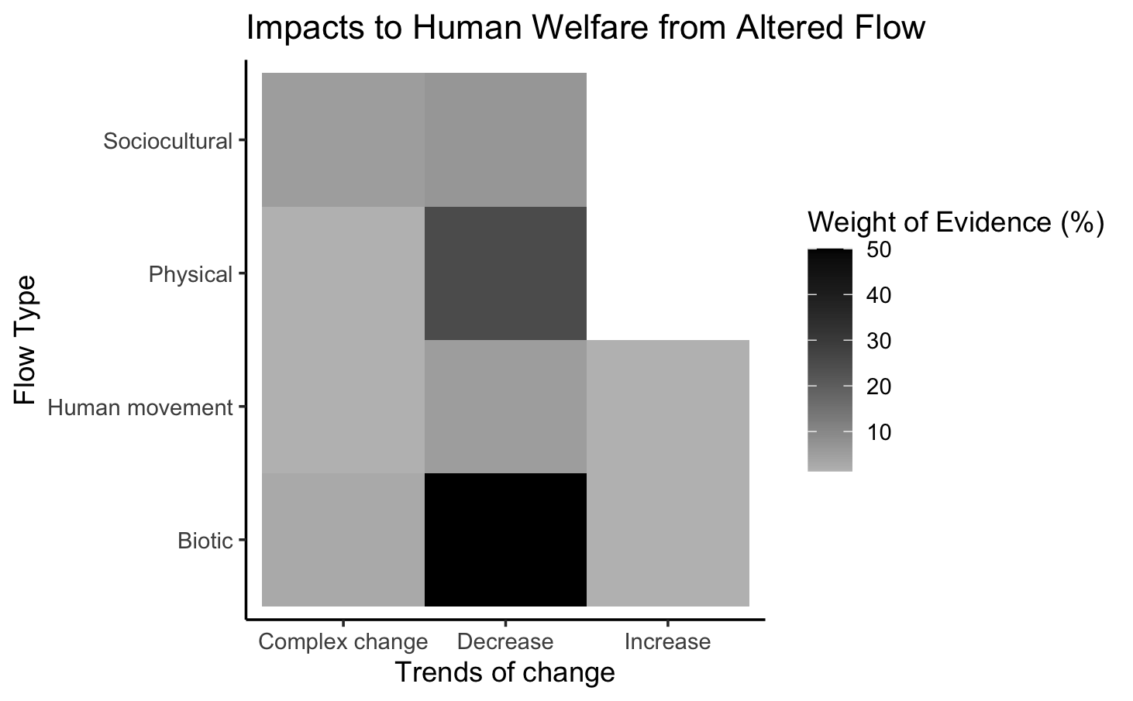
Welfare

Slide 35
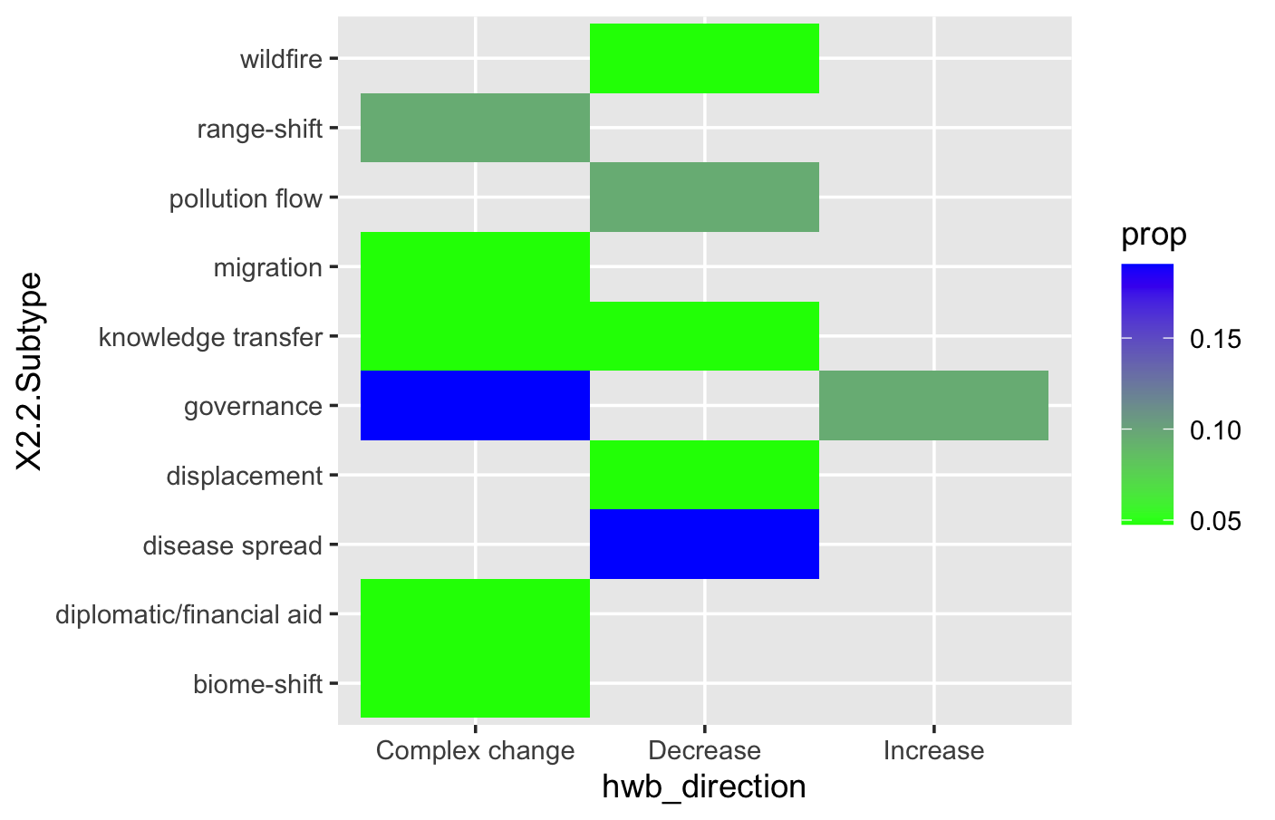
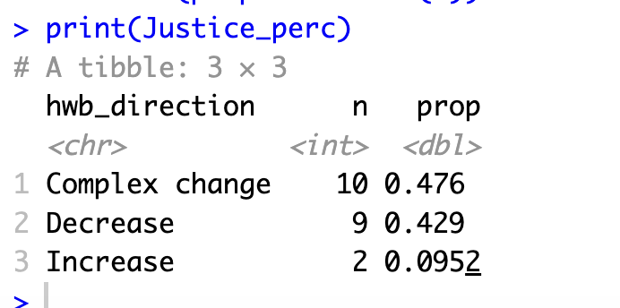
HWB trends: Justice

Slide 36
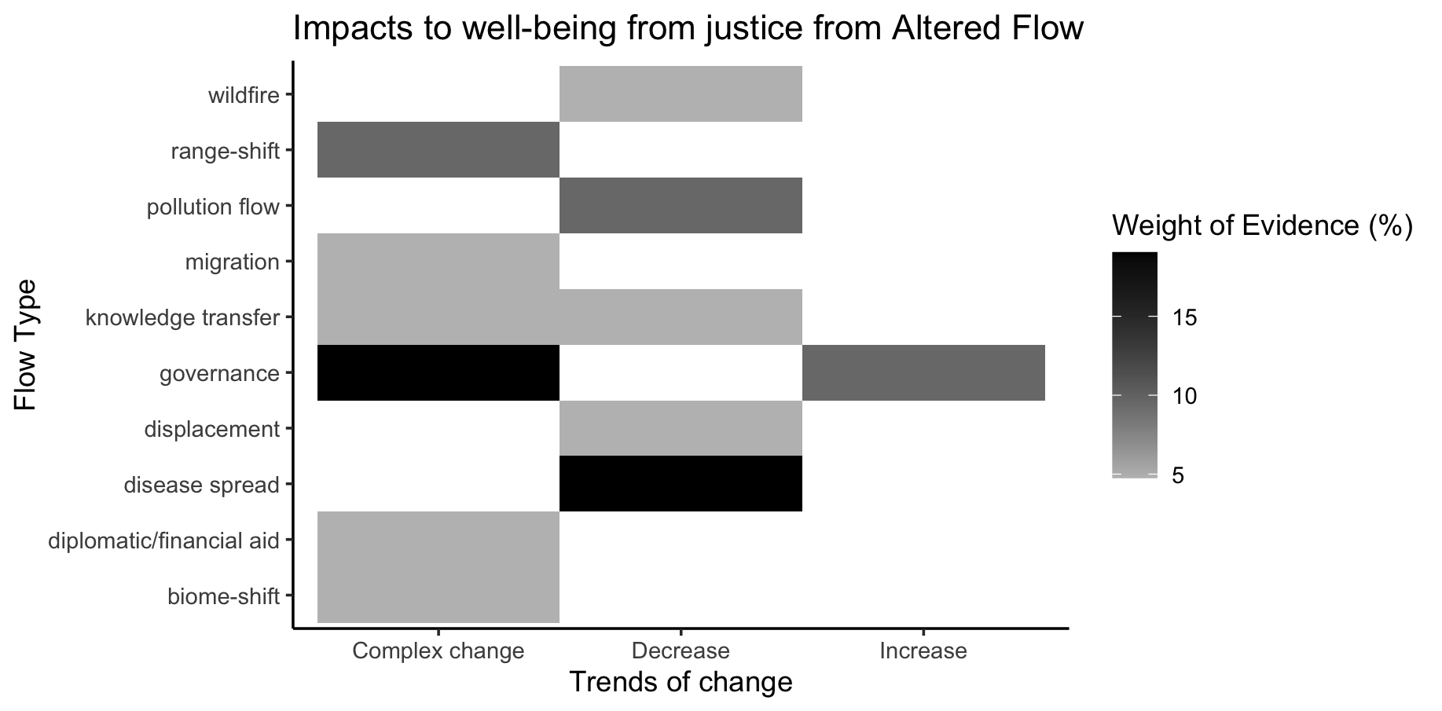

Slide 37
Other hwb in otherhwb.txt

Slide 38
Table 1. Summary of evidence for changes in dimensions of human well-being and knowledge gaps.
Trend type | Well- Established Decreasing | Established Decreasing | Well- Established Complex Changes and Decreasing | Established Complex Changes and Decreasing | Mixed Evidence | Insufficient Evidence
Category | Welfare Relational well-being
n

Slide 39
OLDER:

Slide 41
At least 5 entries – top – to get stats on % of entries or papers on these:

Slide 42
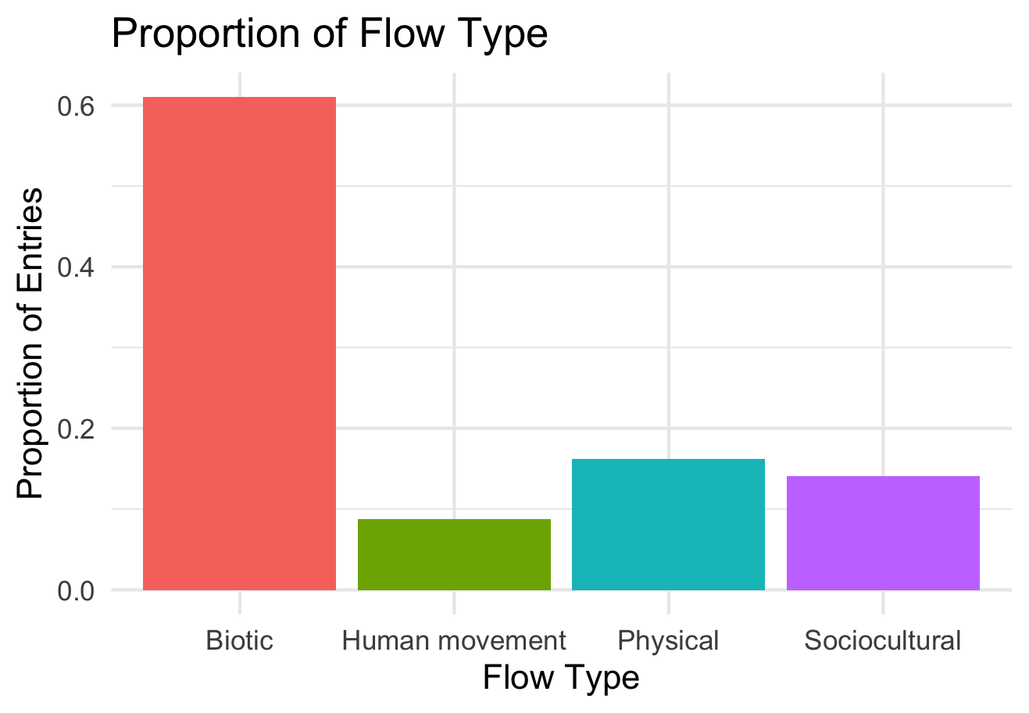

Slide 43
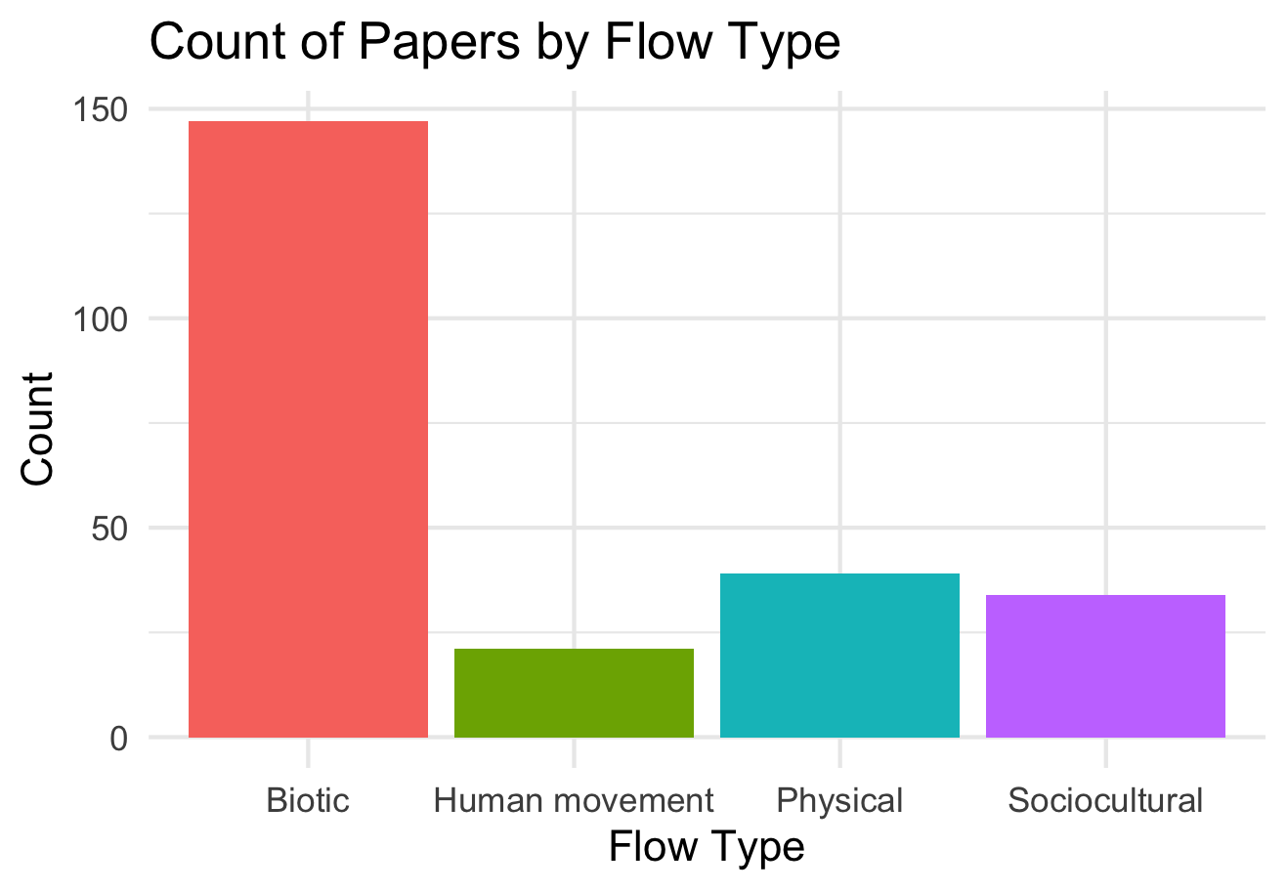

Slide 44
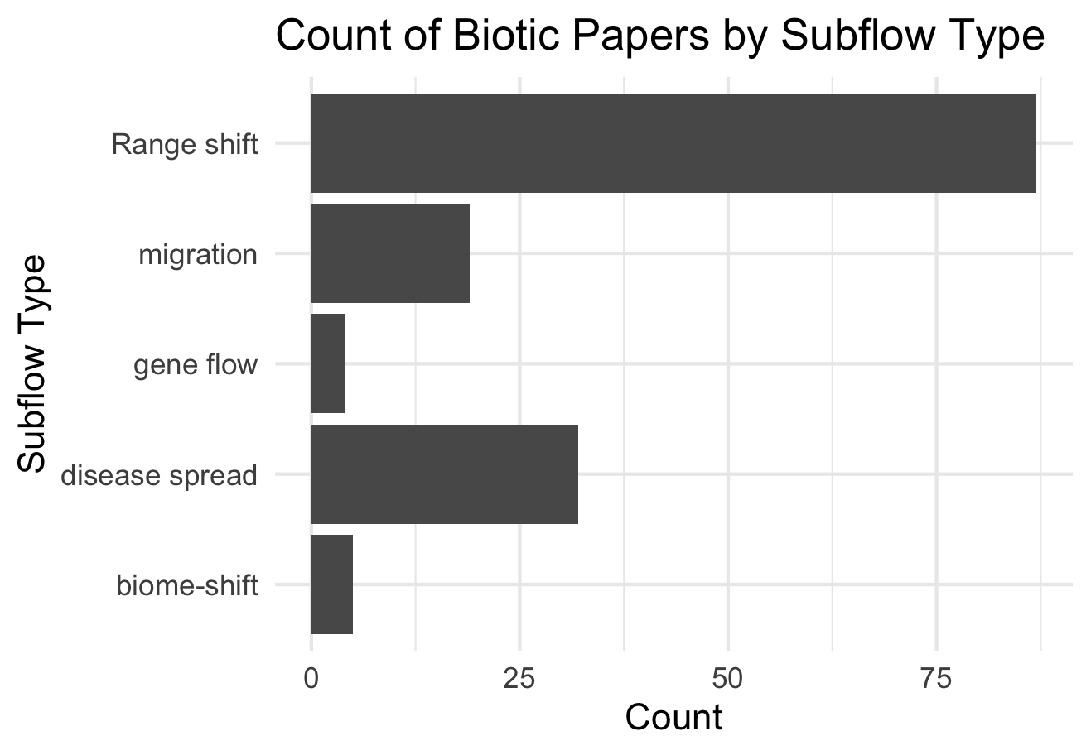

Slide 45
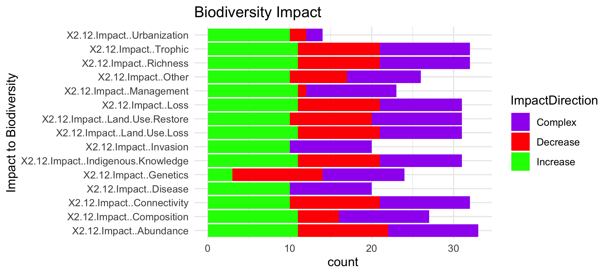

Slide 47
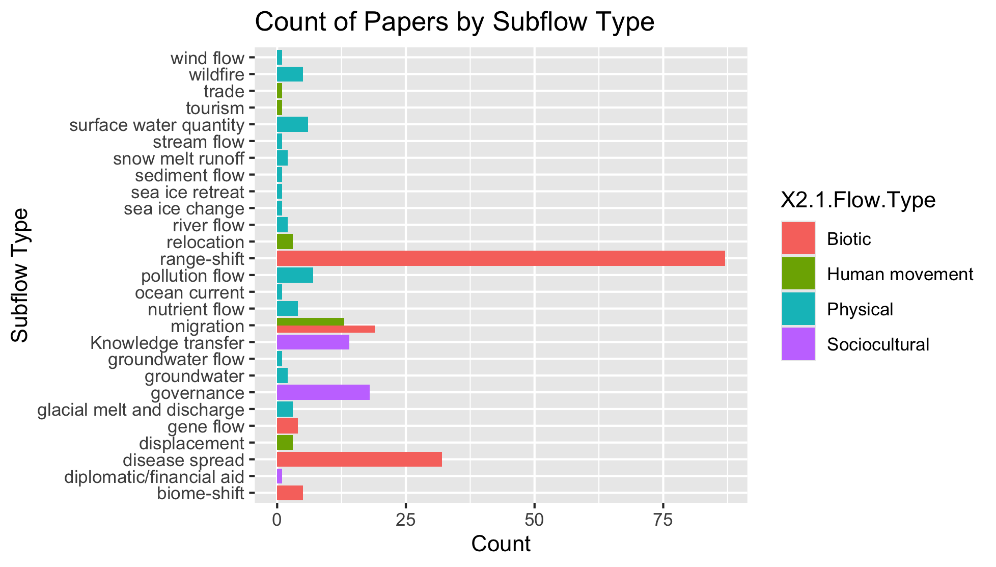
To group physical flow papers

Slide 48
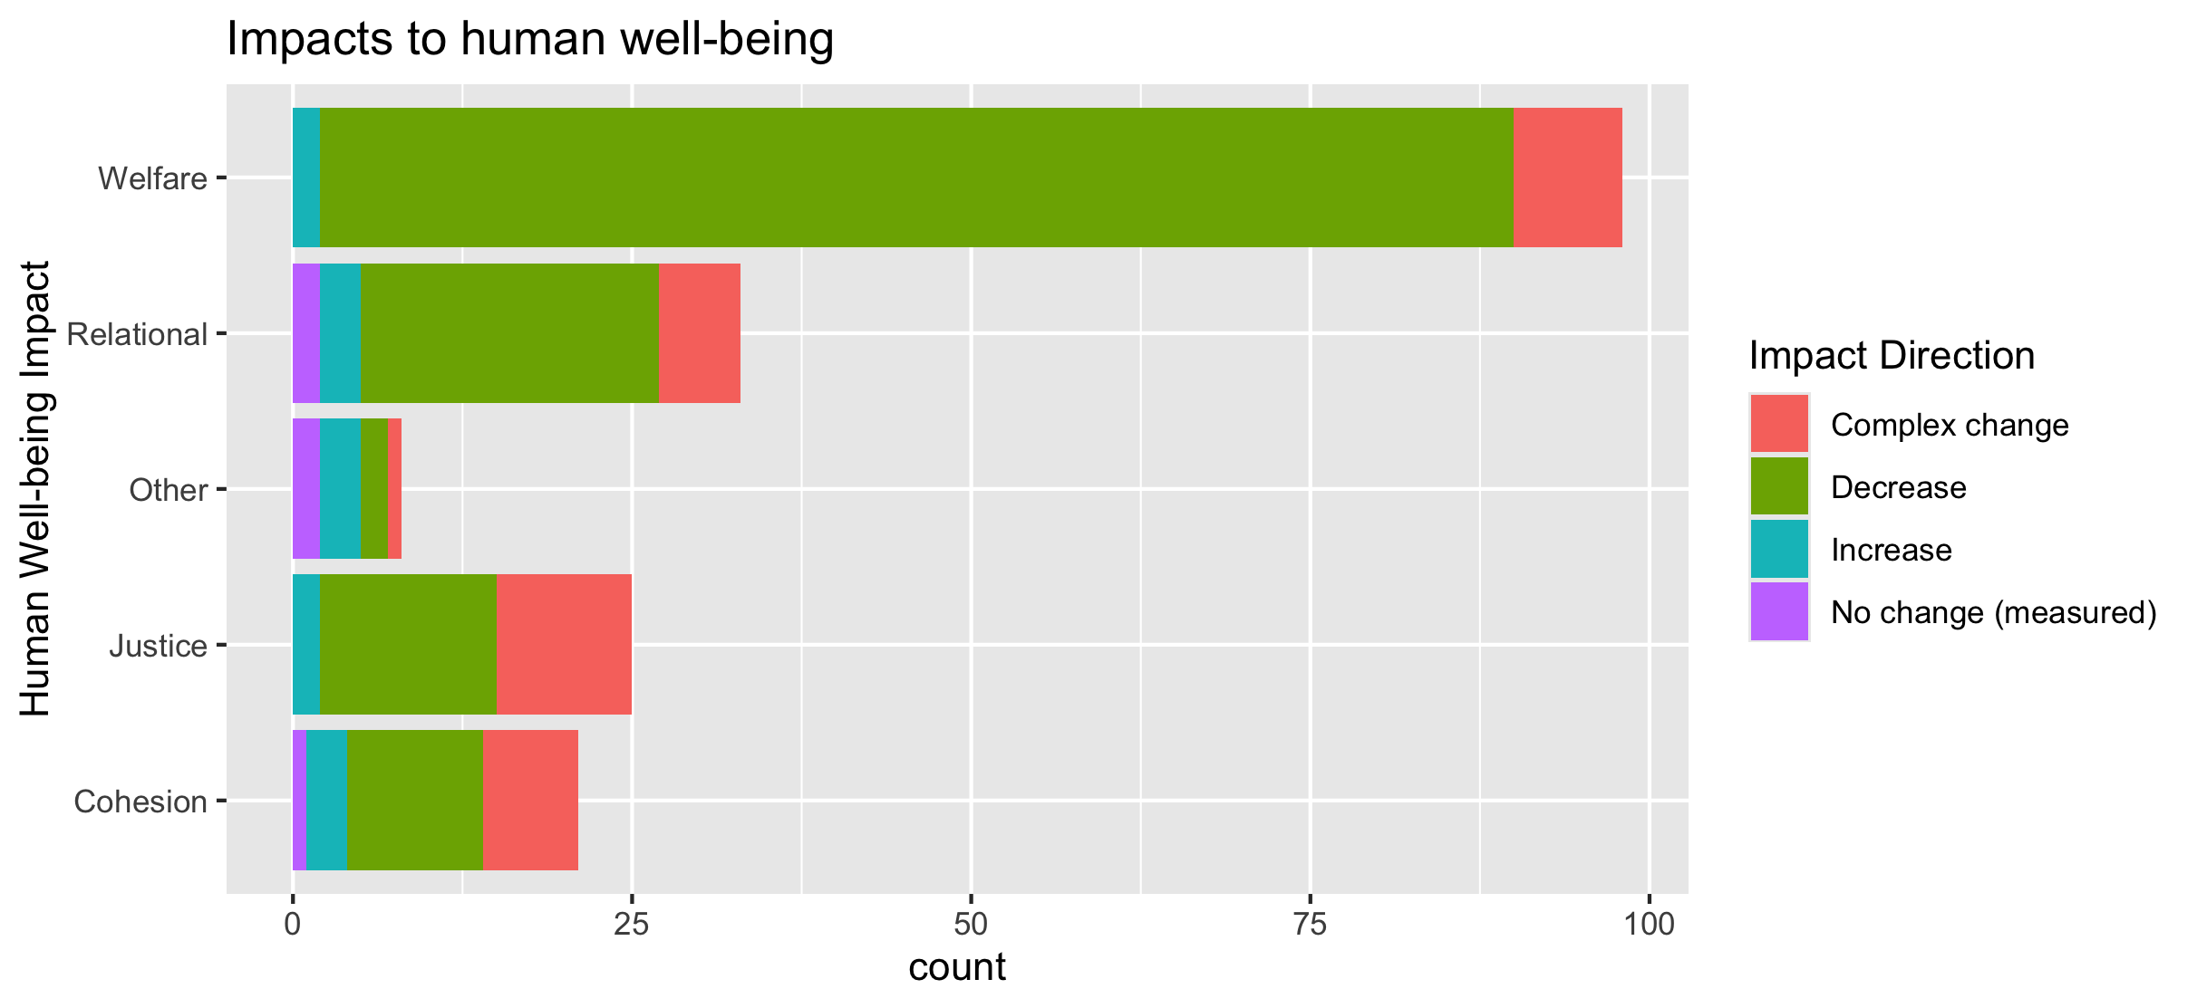
To align direction colors with final color pallet

Slide 49
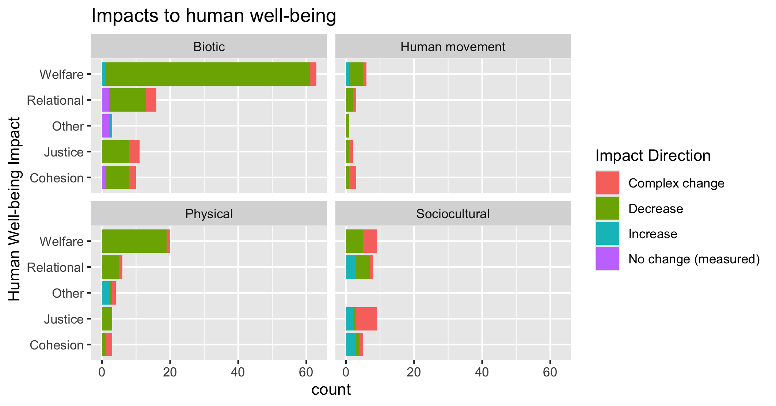
To align direction colors with final color pallet

Slide 50
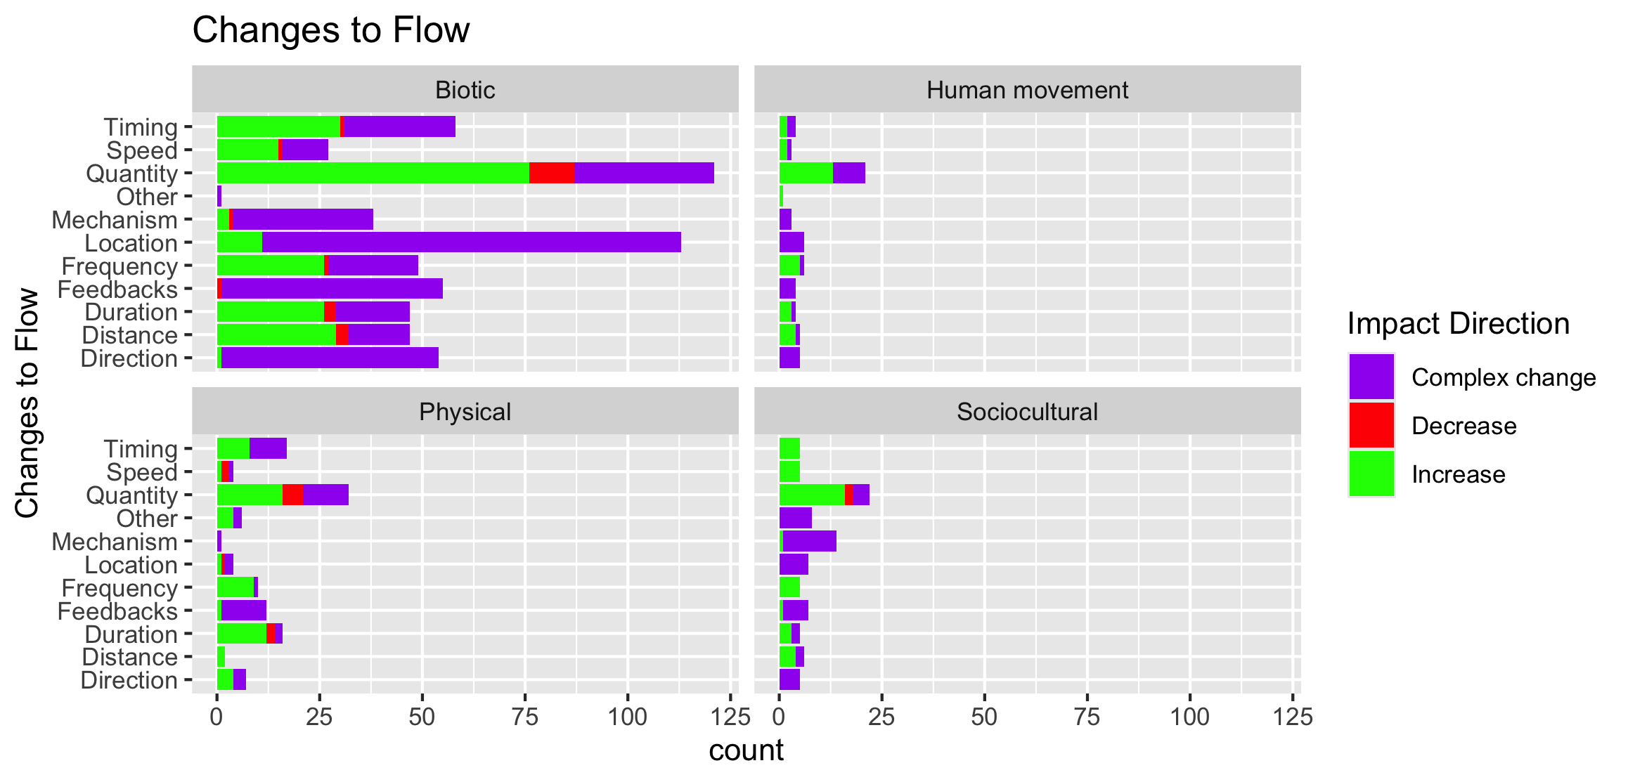

Slide 51
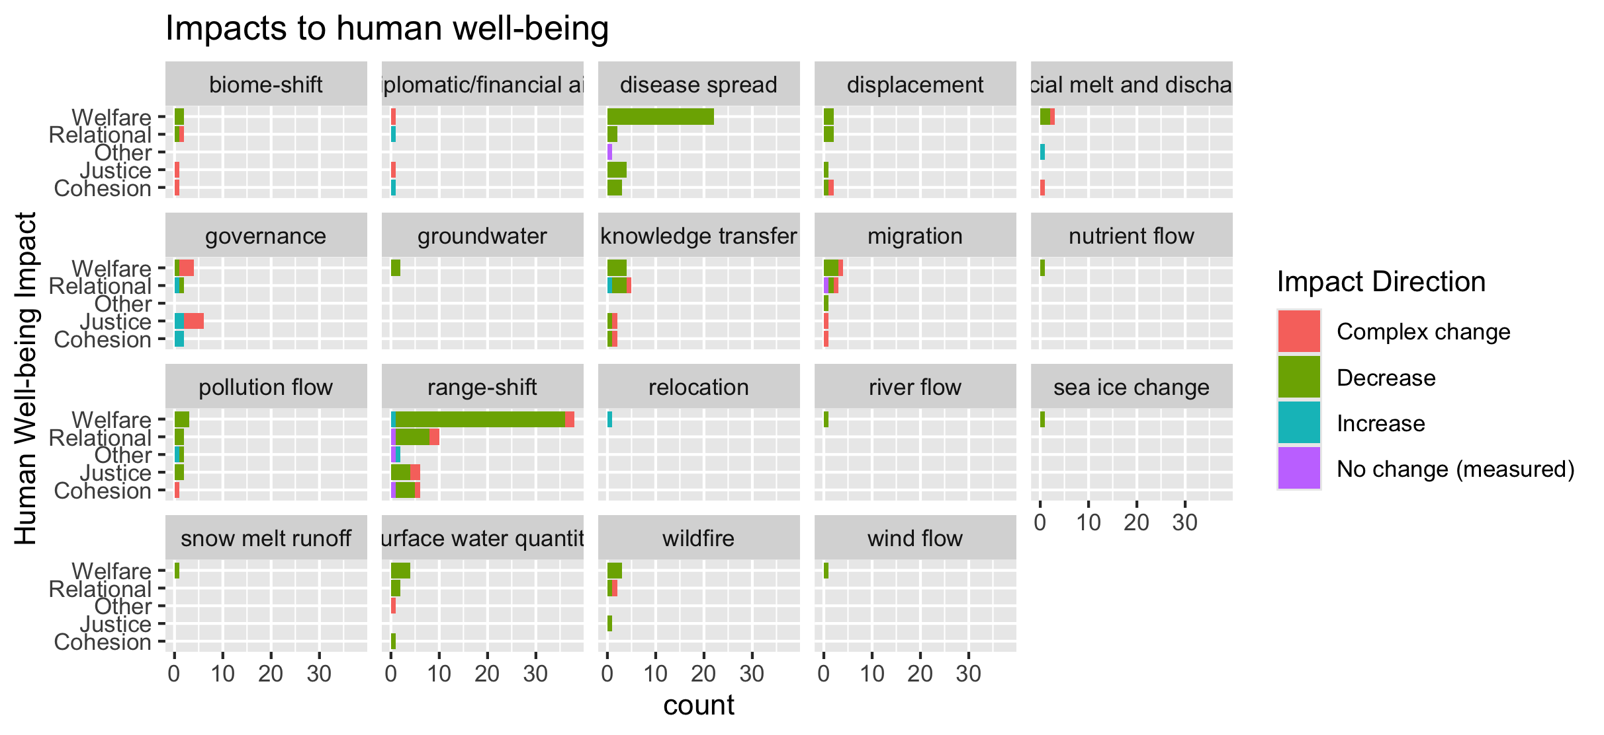
To group physical flow papers

Slide 52
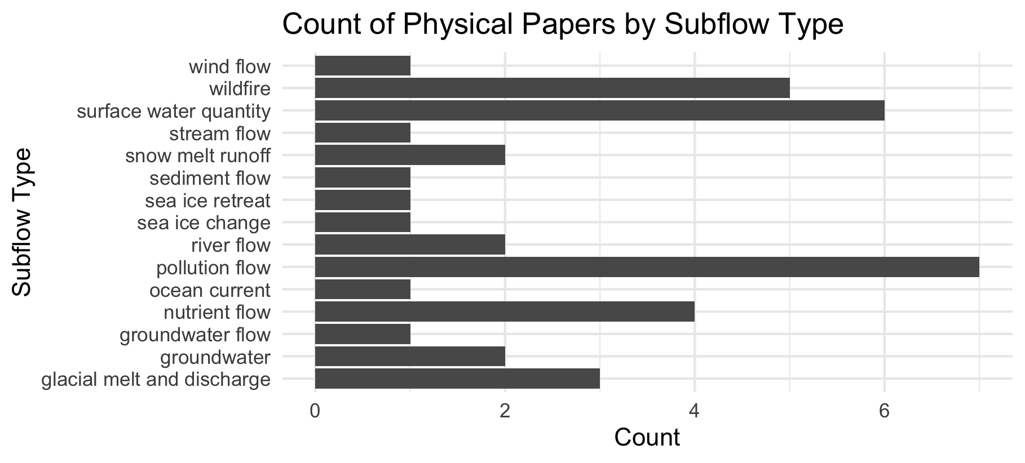

Slide 53
Feb 23 2025

Slide 54
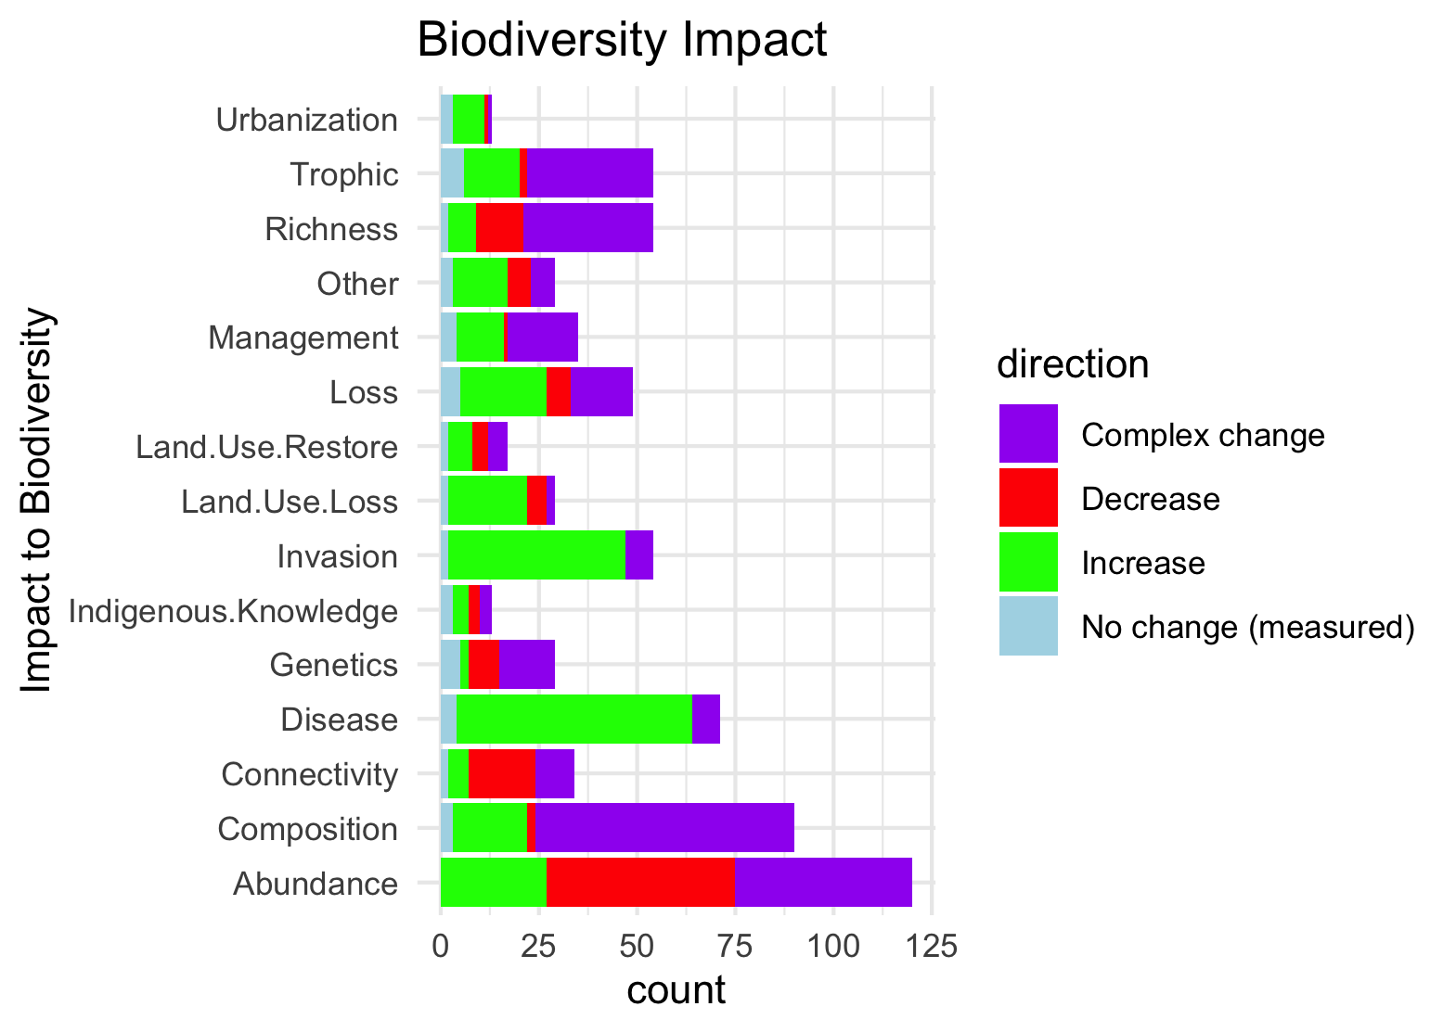
Needs to be grouped by what is good and what is bad to see increase in:

Slide 55
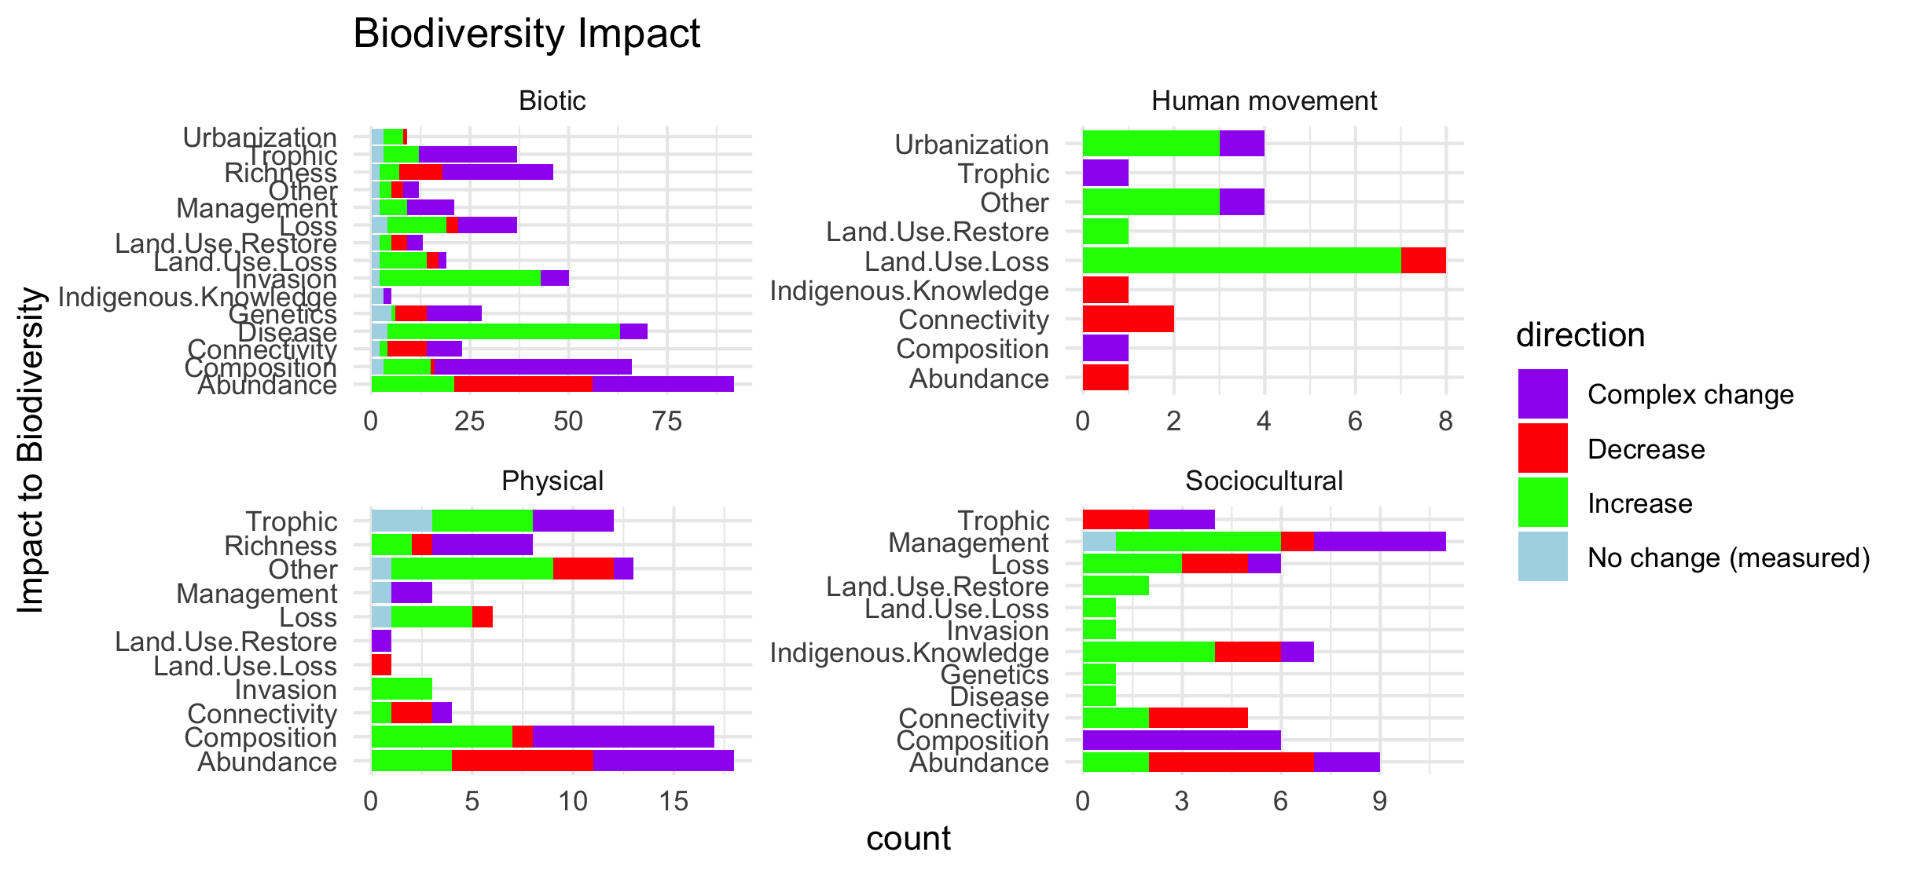
Scale free on the facet (diff x axis)

Slide 56
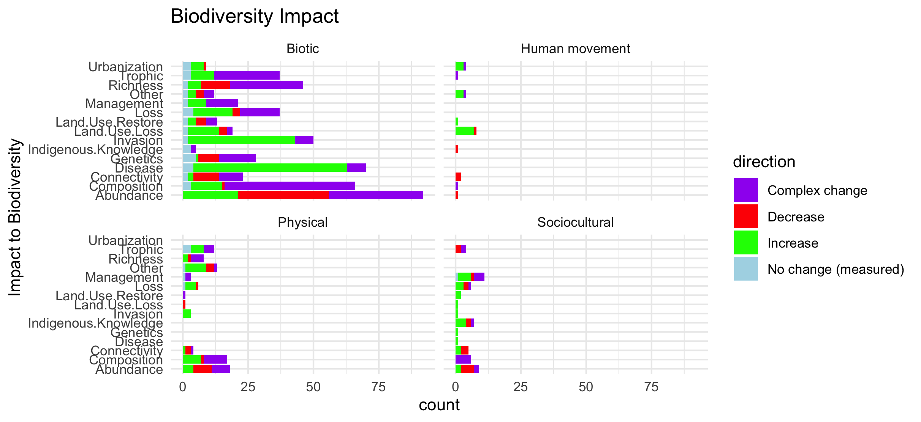
Scale fixed on the facet (same x axis)

Slide 57
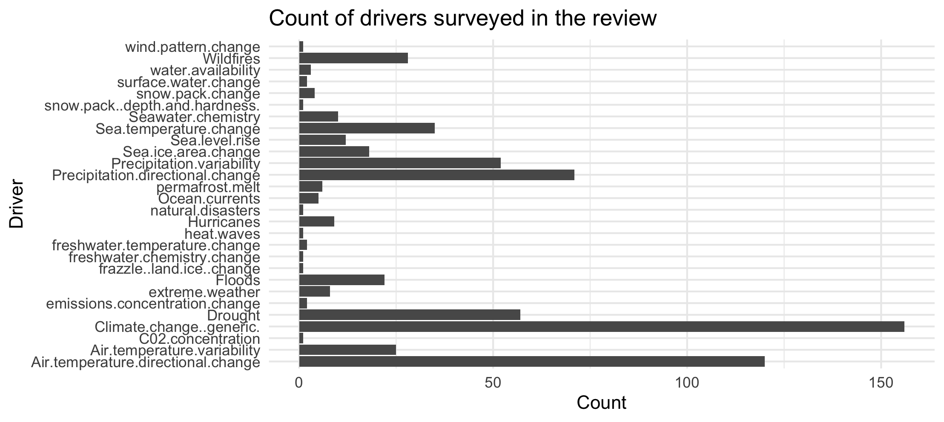

Slide 58
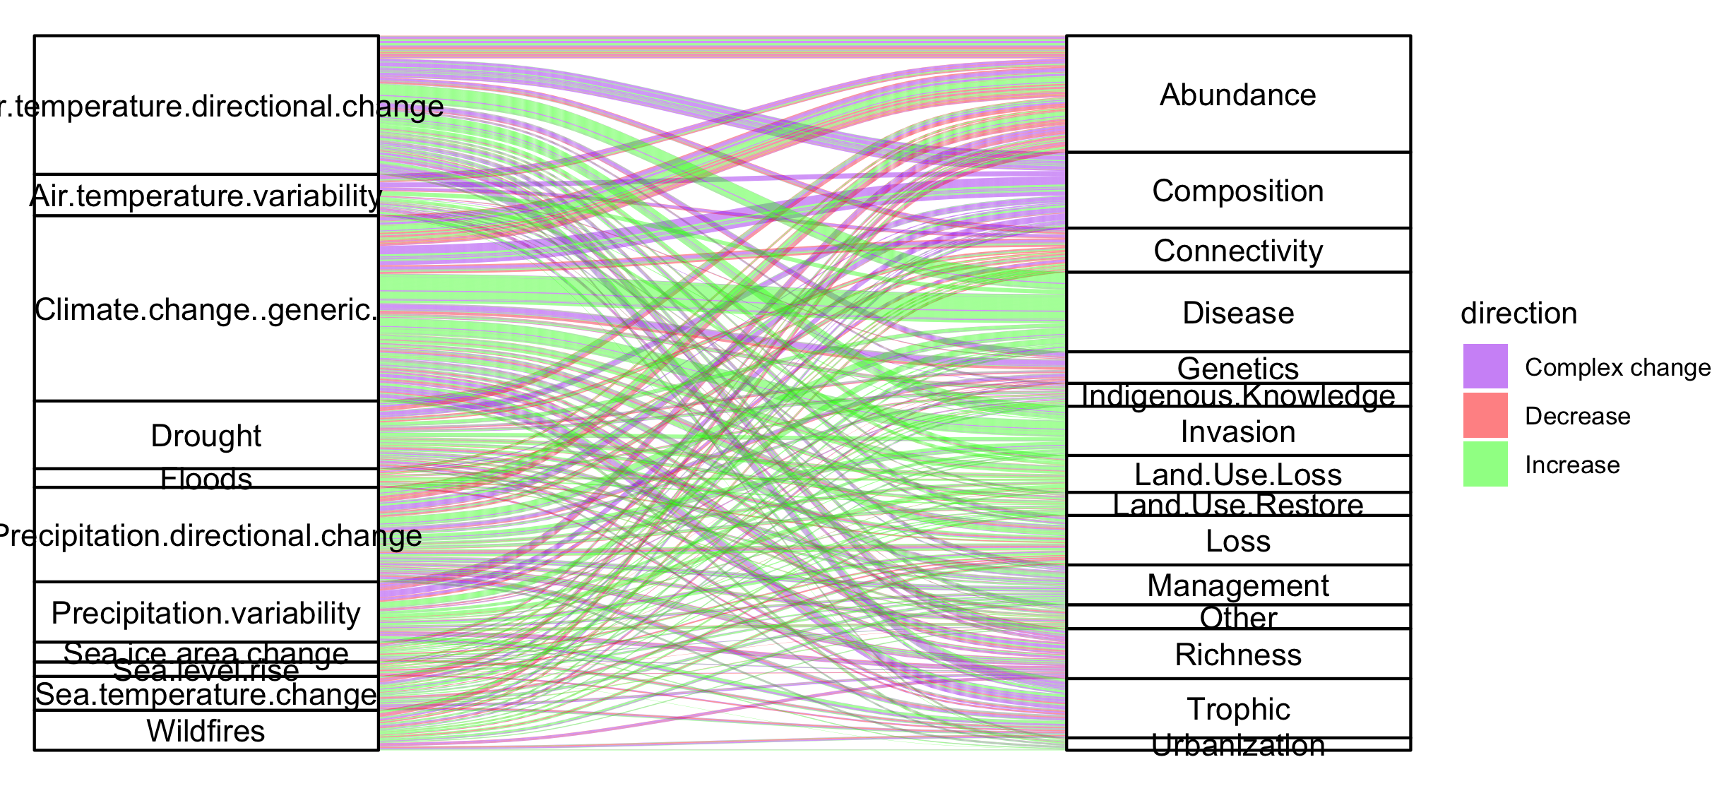
Colleen: see note isn the code – we could group spme of the drivers (hurricaines, extreme weather, ands ome of the ice ones). This still doesnt take into account if changes arw good or bad though and might just be too busy.

Slide 59

#not that informative because so many more of the papers are biotic

Slide 60
NCPs

Slide 61

Fix labels

Slide 62
Do by flow type

Slide 63
Fix labels

Slide 64


Slide 65

Too many drivers

Slide 66


Slide 67
HWB

Slide 68
Connections – how does altered flow relate
Driver~ altered flow (by flow, and subflow – grouped out by flow
Altered flow~ impact (for each category)

